Slide 1

Improving Phase Prediction with Data Assimilation & Interpolated Surfaces
June 2026 Status Update
(Extended ROI & Time Period)
Emma Golub & Zeed Almelhem

Slide 2
Outline
Motivation
Research questions
High level framework
Methodology recap
Final results: performance metrics, SHAP, ablation study

Slide 3
Motivation
Few reliable precipitation phase observations exist beyond sparse airport stations
Crowdsourced data are sparse/unevenly distributed
Models struggle to distinguish rain from snow near freezing temperatures (Yu et al., 2024)
Machine learning methods provide only marginal improvements when using only near-surface synoptic meteorology (Jennings et al., 2025)
Mixed precipitation does not fall within a well-defined physical regime; overlap with other phases near freezing

Slide 4
Research Questions
Do additional predictor data assimilation techniques improve rain/snow predictive accuracy?
MRoS citizen science observations
Station data points
IMERG gridded products (PLP)
PRISM gridded products (temp, mm)
interpolated to a grid surface
Since “mixed” phase is often excluded from predictive analyses, how can we better represent “mixed” precipitation predictions?
3 multiclass distinct phases
Binary (“mix” as uncertainty)
Do these explored elements improve prediction near freezing?

Slide 5
High-Level Workflow and Motivation
Interpolate sparse data (stations, MRoS obs)
Assimilate surfaces with gridded datasets (IMERG, PRISM)
Machine learning to predict precipitation phase probabilities (XGBoost)

Slide 6

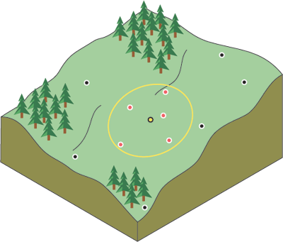
Methodology
Input Datasets
October 2022 - May 2026
Surfaces
Machine Learning
XGBoost
MRoS
Station Data
(WCC, LCD, HADS)
Split MRoS Labels
70/15/15% training/valid/testing
Spatial Interpolation
Dynamic lapse rate adjustment
MRoS
air temp
dew temp
wet-bulb temp
RH
IMERG
IDW
Model Training
DEM
PRISM
Kriging
Validation + Testing
Preprocessing
Time synchr.
Hourly aggregation
+
Output
elevation
IMERG PLP
PRISM temp
p(rain), p(snow), p(mix),
uncertainty
Derive:
t_{dew} , t_{wet} , RH
resampling DEM, IMERG, PRISM
Source: ArcGIS
+
SHAP Analysis

Slide 7
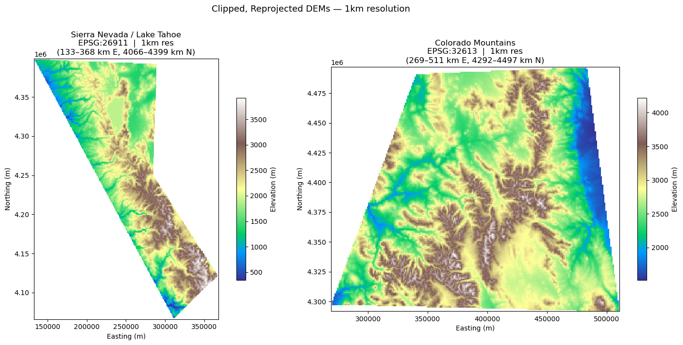
Study Areas: Sierra Nevada (CA) & Rocky Mountains (CO)

Slide 8
Machine Learning Framework
Testing & Evaluation
hold-out test set
MODEL TRAINING
PREDICTORS
Class Weighting
elevation
IMERG PLP
MRoS LOOCV surfaces
air temp
dew temp
wet-bulb temp
RH
LABELS (TARGET)
MRoS Observations (points)
OUTPUTS
XGBoost
Binary
rain / snow
p(rain)
p(snow)
p(mix) derived
Data Splitting
train / test / val
70 / 15 / 15
stratified by phase
Calibration Isotonic regression & betacal
“Mix” Thresholding
Gaussian-half band
Twet conditioned
Feature Interpretation
SHAP
over time and space

Slide 9
Predictors
Stations:
Dew-point temperature
Wet-bulb temperature
Air temperature
MRoS leave-one-out-cross-validated (LOOCV) surfaces
IMERG: probability of liquid precip
DEM: Elevation
Interpolated
Gridded products

Slide 10
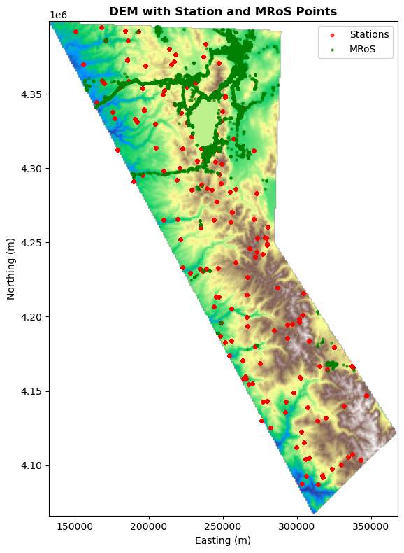
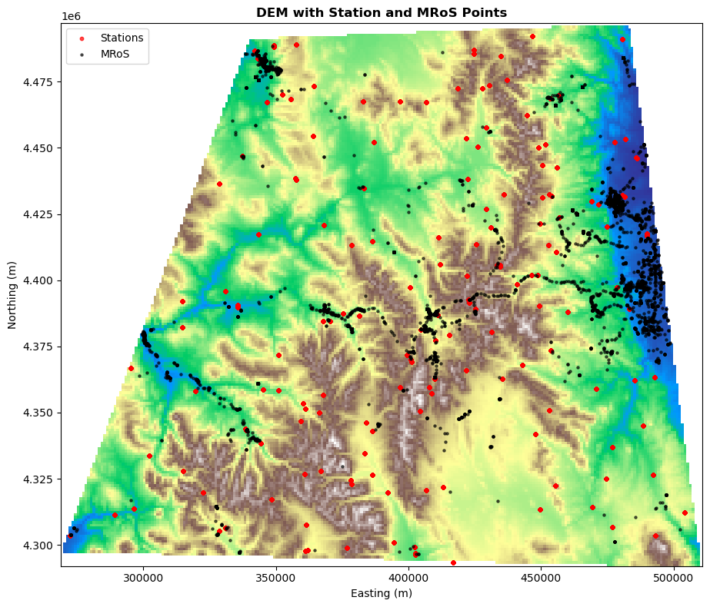
Study Areas: Sierra Nevada (CA) & Rocky Mountains (CO)
Notes:
Rerun to change green color of MRoS stations in CA extent to BLACK

Slide 11
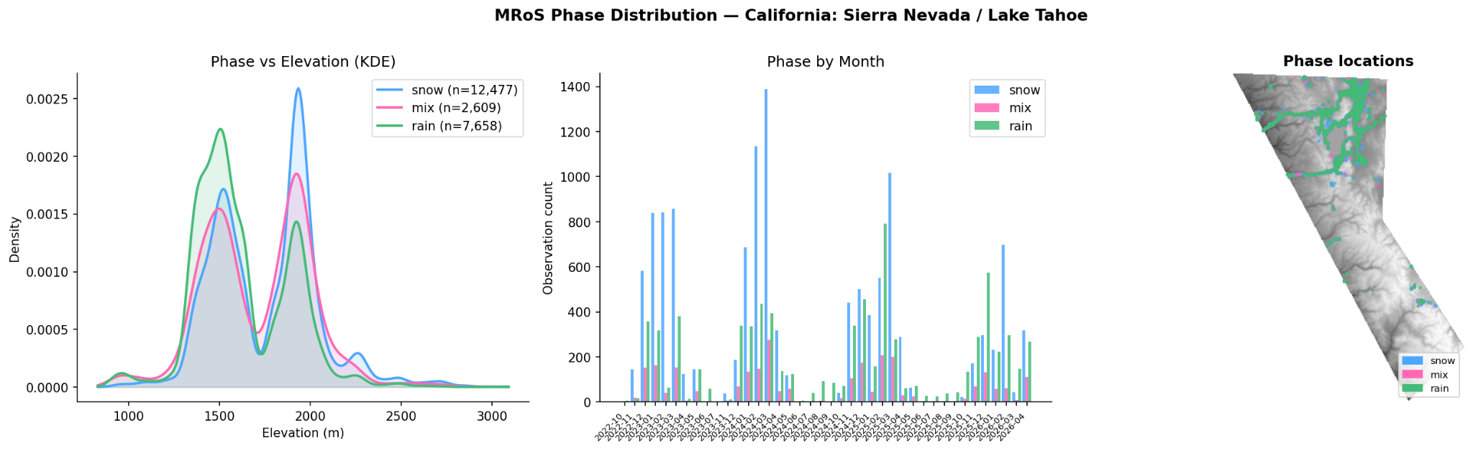
MRoS Datasets
Notes:
Adjust to better visualize phase locations overlap - also consider talking more to how we EXCLUDE the summer non-obs seasons

Slide 12
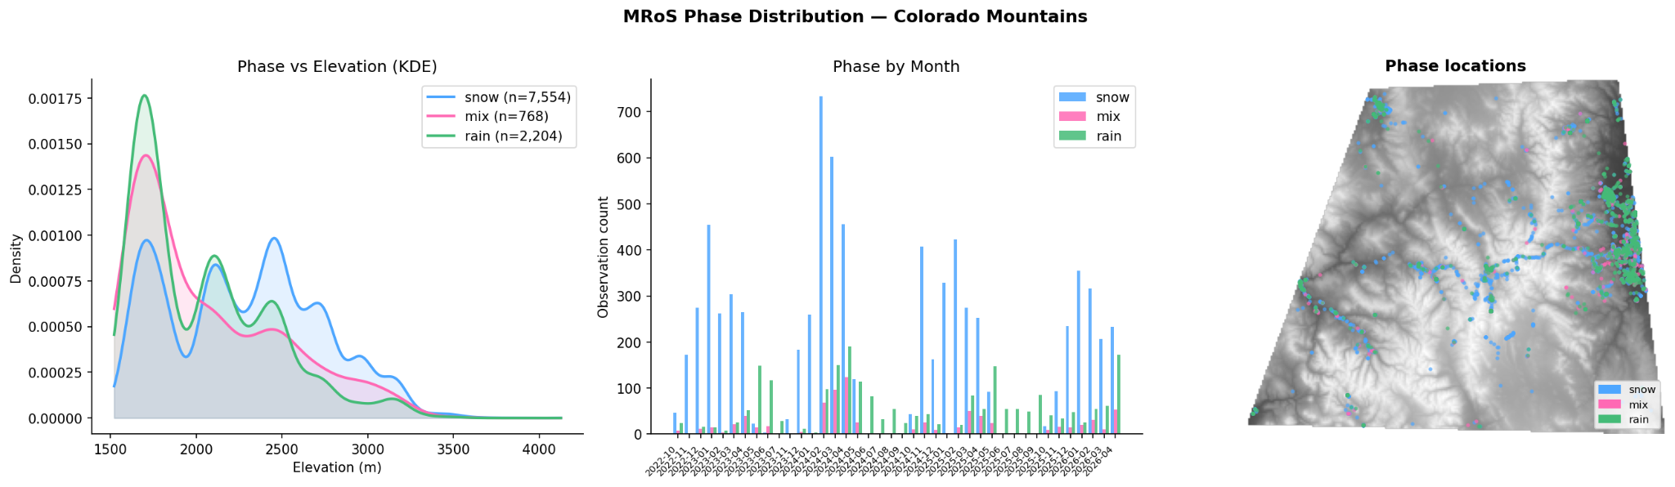
MRoS Datasets
Notes:
Adjust to better visualize phase locations overlap

Slide 13
M M M
2022
2023
Notes:
Subregion to investigate most balanced dataset? To prove imbalance is affecting SHAP feature – run on a subset of elevation

Slide 14
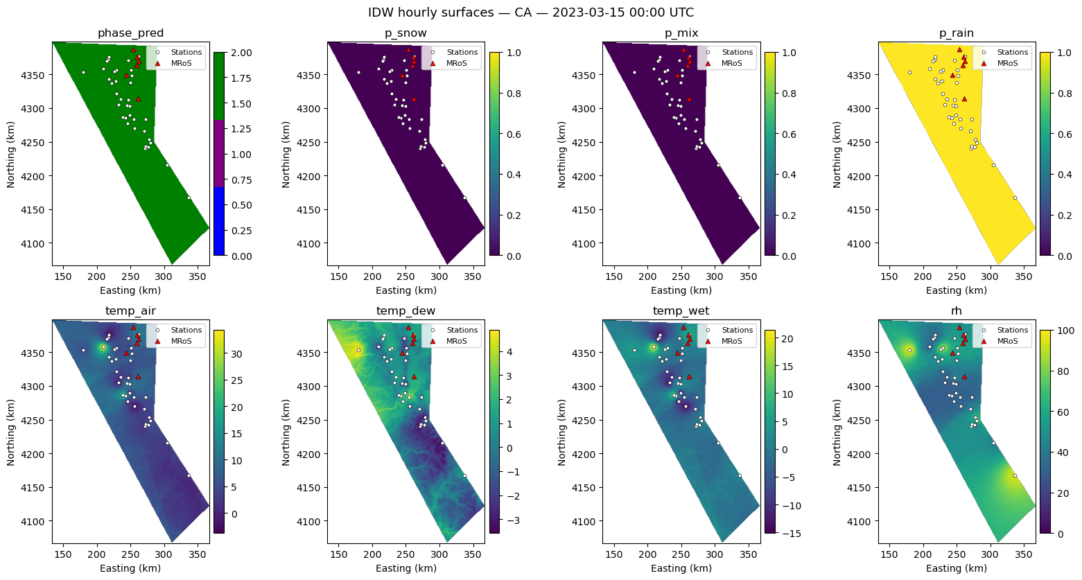
Select Predictors: IDW-ed Surfaces

Slide 15
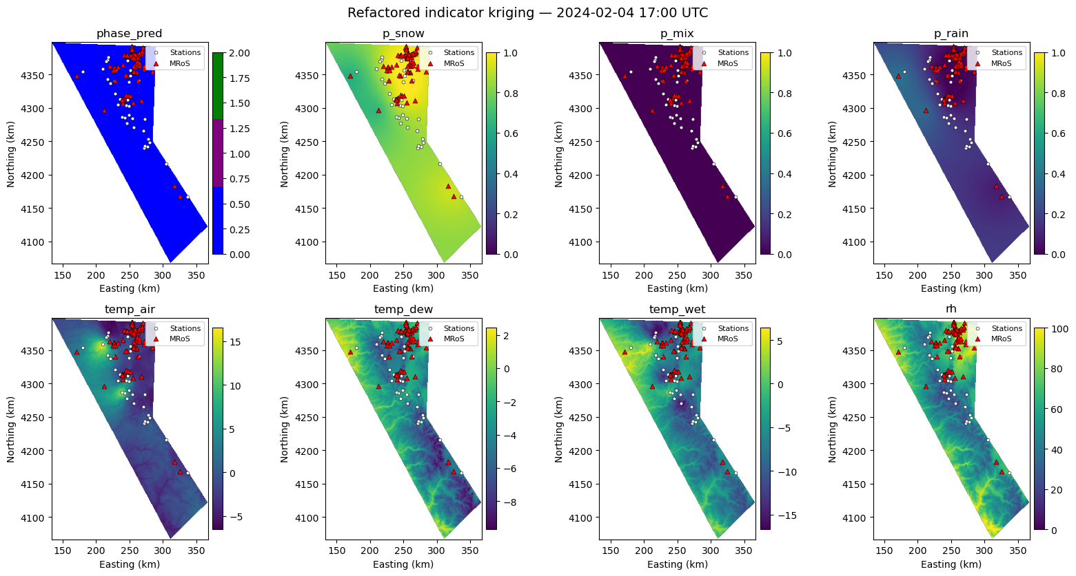
Select Predictors: Kriged Surfaces

Slide 16
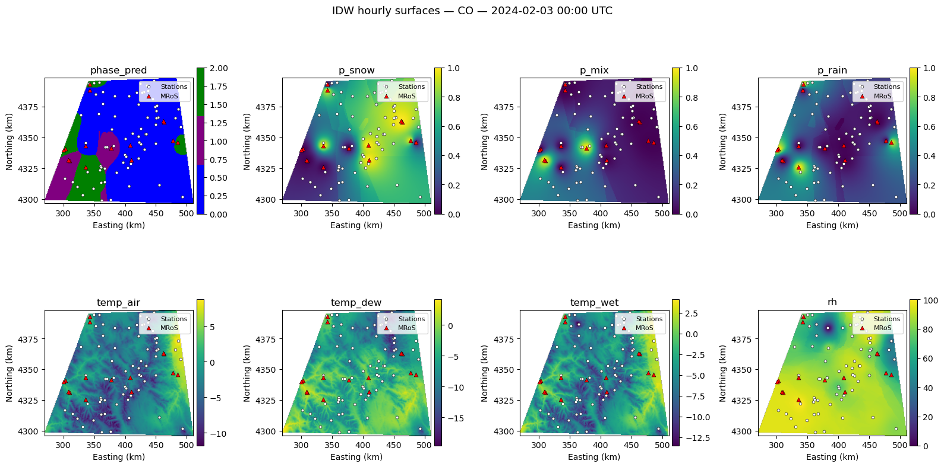
Select Predictors: IDW-ed Surfaces

Slide 17
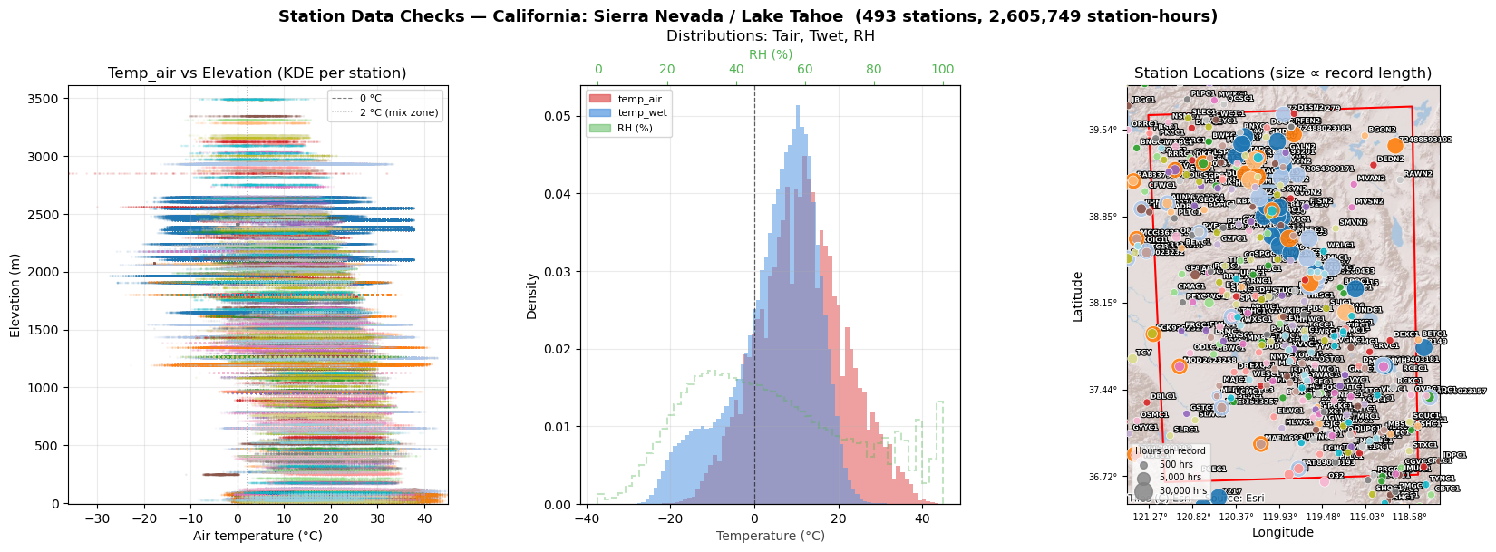
Predictors: Distribution figures
CA exhibits much wider variety of air temperature with elevation than CO

Slide 18
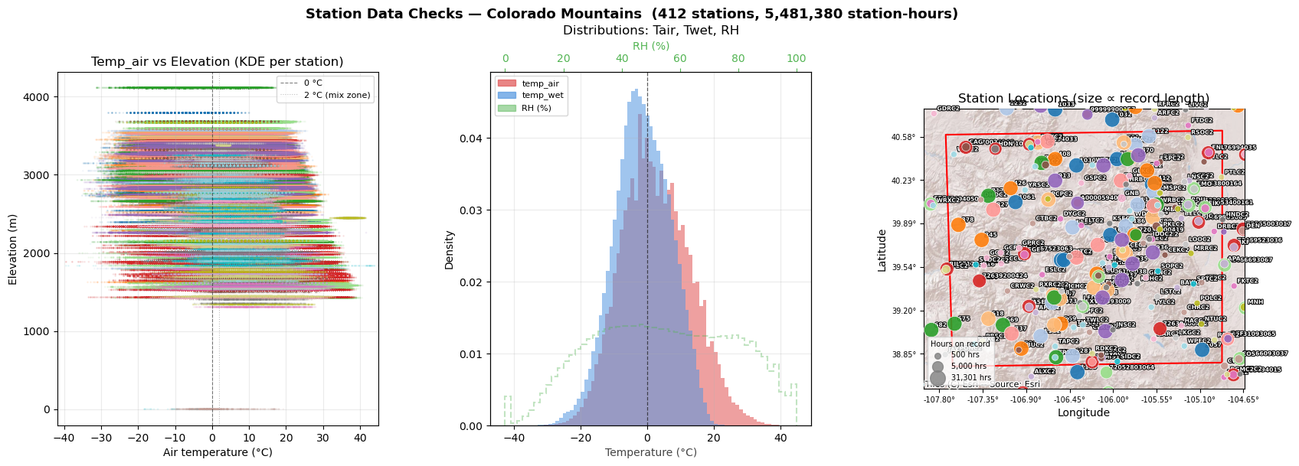
Predictors: Distribution figures
CA exhibits much wider variety of air temperature with elevation than CO

Slide 19
Machine Learning
Architectures we explored:
Multiclass (rain/snow/mix) prediction of phase probabilities
Binary (rain/snow) prediction of phase probabilities + “mix” phase as uncertainty
Train on rain/snow observations only (excluding mix)
Calibration → model scores to probabilities
Optimized wet bulb threshold abstention band reflects “mix” from model uncertainty
Mix = region where the model cannot confidently separate rain and snow

Slide 20
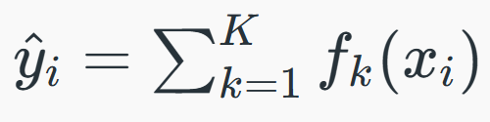

Machine Learning Model: XGBoost
XGBoost: tree-based optimized gradient descent
“Boosting”: each tree corrects errors from the previous one (iteratively optimized)
objection function: loss + regularization terms
Why XGBoost?
Prevents overfitting
Handles sparsity

Slide 21
Machine Learning Framework
Testing & Evaluation
hold-out test set
MODEL TRAINING
PREDICTORS
Class Weighting
elevation
IMERG PLP
MRoS LOOCV surfaces
air temp
dew temp
wet-bulb temp
RH
LABELS (TARGET)
MRoS Observations (points)
OUTPUTS
XGBoost
Binary
rain / snow
p(rain)
p(snow)
p(mix) derived
Data Splitting
train / test / val
70 / 15 / 15
stratified by phase
Calibration
“Mix” Thresholding
Gaussian-half band
Twet conditioned
Feature Interpretation
SHAP
over time and space

Slide 22
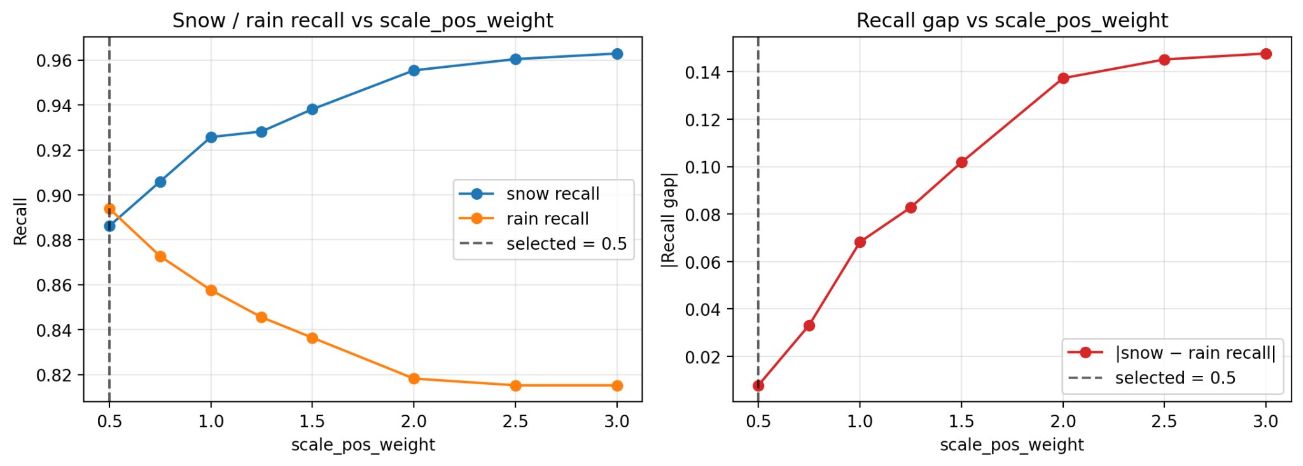
Managing Class Imbalance
MRoS stations skew toward high-elevation & more snow obs than rain → so model learns to favor snow
Frequency-based reweighting?
That fixes count imbalance, not the recall asymmetry we actually see…
Solution: Tune XGBoost's scale_pos_weight empirically → sweep over candidate values
scale_pos_weight < 1 downweights the majority snow class
For each candidate: evaluate snow recall vs. rain recall on the validation set
Select the value that minimizes: |snow recall − rain recall|
E.g., Selected value: 0.50 →
snow recall 0.890
rain recall 0.900
gap = 0.010 !

Slide 23
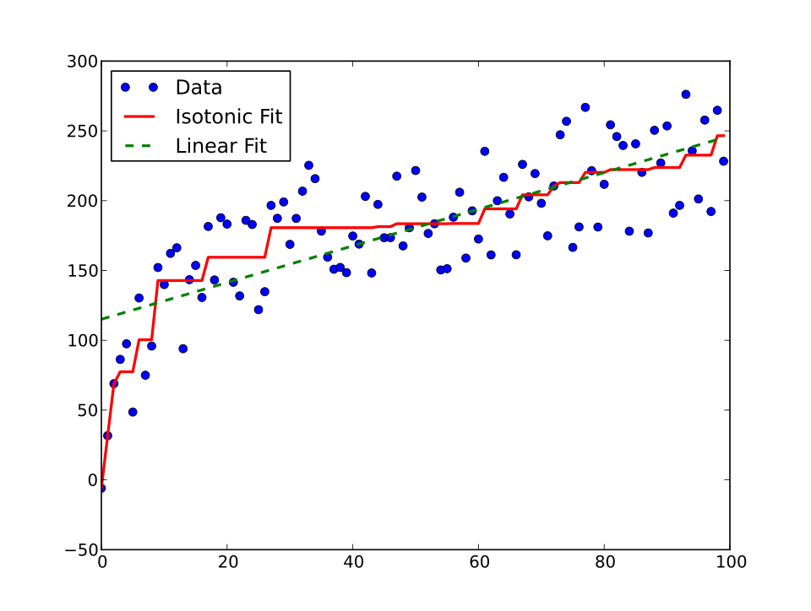
Calibration (for CO)
XGBoost scores are well-calibrated for ranking, not for stated probabilities → a score of 0.80 ≠ 80% snow
Isotonic regression calibration: maps the raw scores to corrected probabilities by fitting an increasing step function that minimizes the difference between predicted probabilities and observed outcomes on held-out data
non-parametric and monotone: no distributional assumption, but it can produce flat steps and overfit small samples
Separate calibration models for near-freezing observations (|T_wet| ≤ 2°C) and clear-phase observations (|T_wet| > 2°C)
Use 10-fold cross-fitting so every obs gets a calibrated probability from data it wasn't part of

Slide 24
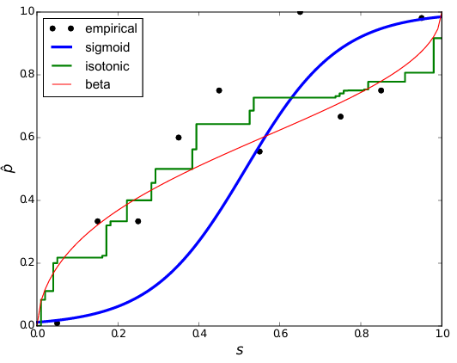
Calibration (for CA)
XGBoost scores are well-calibrated for ranking, not for stated probabilities → a score of 0.80 ≠ 80% snow
What if the XGBoost ranked probability results are trending so far towards the extreme and a non-parametric approach like isotonic calibration doesn’t do a great job? i.e., CA dataset
Beta calibration (Kull et al., 2017):
fits a 3-parameter map derived from beta distributions → flexible enough for extremely skewed score distributions
Parametric: stable with few observations near the extremes (where isotonic has the least data to fit)
We use betacal for the large bimodal CA dataset & isotonic for sparser CO dataset – chosen by validation Brier/ECE

Slide 25
Handling “Mix” Phase
We’ve implemented a binary model to predict RAIN or SNOW… why didn’t we include “MIX” as a third phase in a multi-class approach instead?
Mix is only ~10% of labels, has no distinct physical regime (overlaps with rain/snow near freezing), and observer definitions of 'mix' are inconsistent → a trained third class just learns label noise
Multiclass also degrades the rain/snow boundary: gradients from noisy mix labels pull away from the decision surface in the near freezing regime
Binary + abstention keeps the supervised signal clean and converts mix into an operational flag that shows where the model is uncertain
So how can we handle “mix” observations from MRoS data to make use of the full labels without deteriorating model performance?
Observer-reported mix events can serve as an external validation of where the band lands in temperature and probability space
We’re not claiming the model will learn to detect mixed phase → we’re asking whether its uncertainty concentrates in the same physical regime where human observers also reported ambiguity

Slide 26
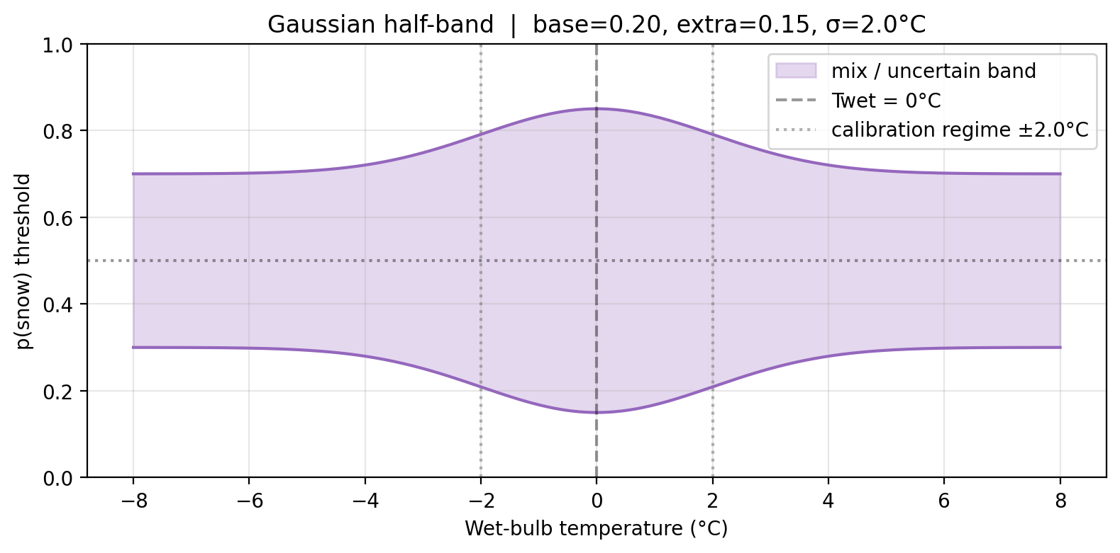
Handling “Mix” Phase: Uncertainty Gaussian Half Band
Let’s define a boundary where the model is having the most trouble ascertaining snow vs rain… and we’ll later check if it overlaps with true mix observations
Requires a threshold… but how to avoid fixed, arbitrary ones?
band as an operational abstention mechanism
Gaussian half-band – threshold width varies continuously with wet-bulb temperature
Widens near 0°C (ambiguous zone) → more observations flagged as uncertain/mixed
Narrows far from freezing (deterministic zone) → confident snow/rain calls preserved
Shape tries to mirror the empirical mix distribution rather than imposing a box
Example selection:
Thresholds at T_wet = 0°C:
rain < 0.15
mixed 0.15–0.85
snow > 0.85
Thresholds far from freezing:
rain < 0.30
mixed 0.30–0.70
snow > 0.70
Three parameters optimized on validation set (incl. observed mixed obs): base, extra, σ
half_band(T_wet) = base_half_band + extra_half_band × exp(−T_wet² / 2σ²)
rain_thresh = 0.5 − half_band(T_wet) snow_thresh = 0.5 + half_band(T_w)
Notes:
abstention test in ML refers to evaluating a model’s ability to refuse to answer; identifying its own limitations

Slide 27
What exactly is “Mix” in the end?
Mix ≠ phase class that the model detects
It’s the region where the model can’t confidently separate rain from snow
Abstention, not prediction
3 things can land an observation in the band
Truly mixed precipitation
Conflicting predictor decisions
Sparse local data
Validation logic: does the model uncertainty concentrate where citizen scientists report mix?
Notes:
It's a post-hoc construction applied to a binary probability output

Slide 28
Performance Metrics
What does this tell us? | Metric | Description
Did the model predict accurately? | Confusion Matrix | Of all true snow/rain/mix observations: the % that the model label correctly vs. mix up
 | F1 Score | Single number per class; lower if the model either misses too many events or raises too many false alarms. “Macro” F1 is average of F1 across each class.
How well does the model separate phase? | AUROC | Area under curve of the true positive rate against the false positive rate. Closer to 1 the better
 | AP | Average precision: similar to & more strict than AUROC
How trustworthy are the predictions? | Reliability | Reveals over/under confidence; when model says "70% chance of snow," does snow actually occur ~70% of the time?
 | Brier Score | Mean squared error between predicted probability and truth. Lower score means less error.
 | ECE | Expected calibration error: alignment between predicted probabilities and observed outcome frequencies across binned probability ranges.

Slide 29
Results
Binary Model on CA
(kriging-based interpolated MRoS and station predictors)

Slide 30
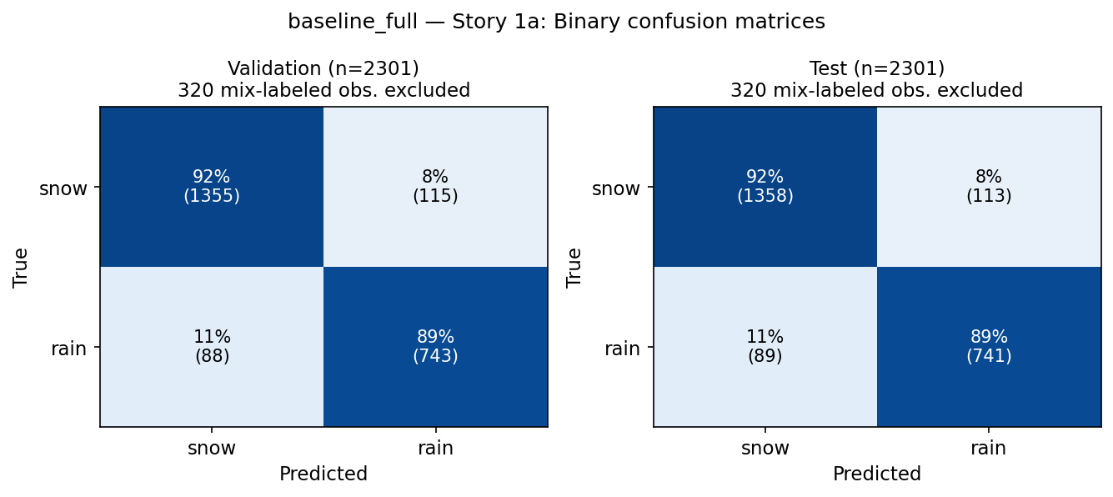
Confusion Matrices

Slide 31

Confusion Matrices

Slide 32
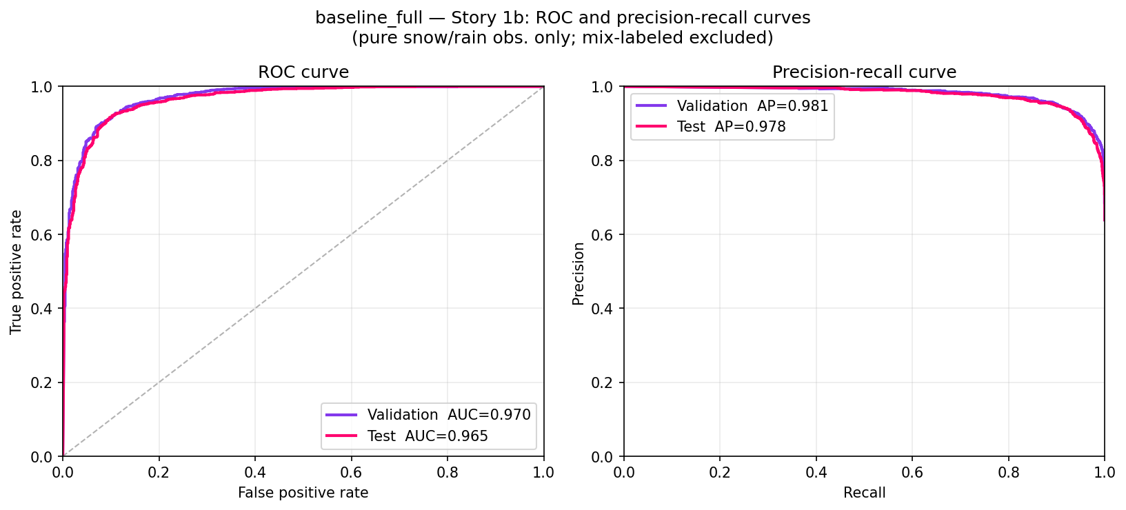
AUROC, AP
Notes:
PR curve still reflecting class imbalance, but strong AP - snow dominated; showing what we know already, not necessarily model skill

Slide 33
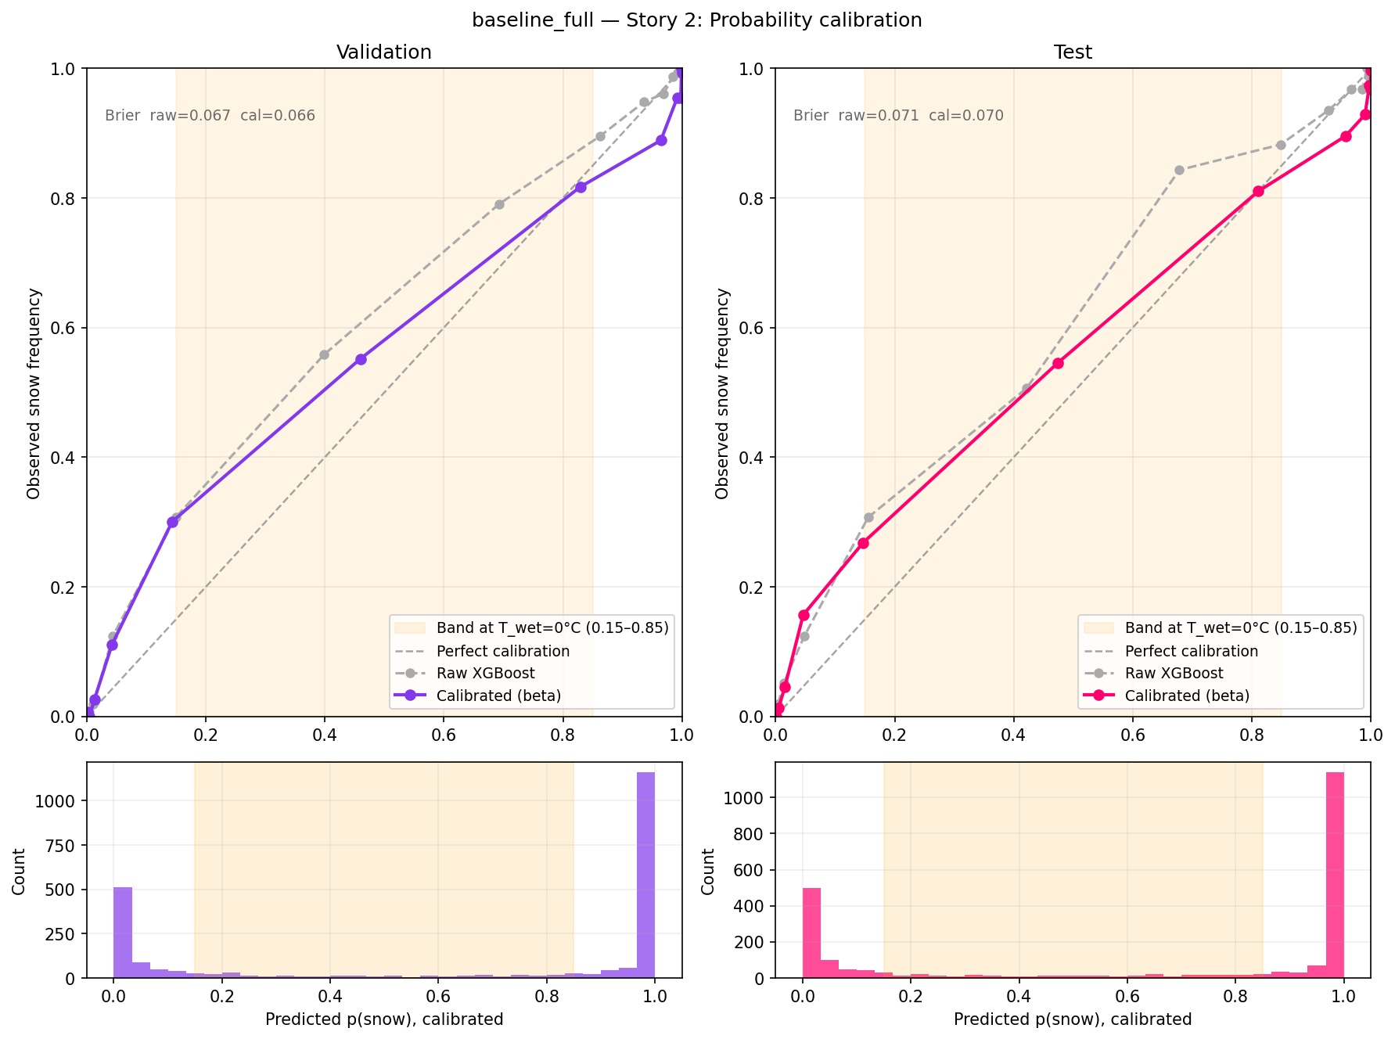
Betacal on large, bimodal CA dataset.
Calibration pulls raw XGBoost scores closer to diagonal line of perfect calibration.
Miscalibration still exists on p(snow) extremes even after calibration.
But low brier scores indicate strong accuracy overall.

Slide 34
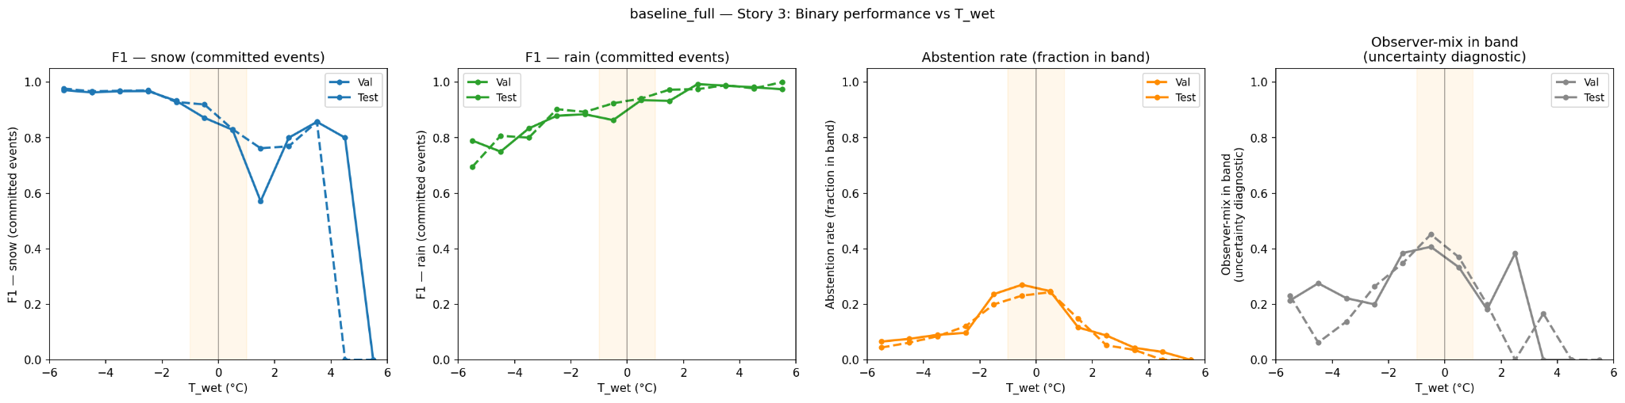
F1 Accuracy (CA)
Fraction of true "mix" events the model places in the mix band → measures whether the model's uncertainty is calibrated to the right temperature range.
Snow predictive accuracy is strong in clear phase regions (outside of freezing) but deteriorates near freezing and reaches the lowest point at ~1.5°C. F1 also deteriorates after 4°C when phase transitions from solid to liquid.
At what temperatures does the model decline to commit?
(denominator is all predictions in that T_wet bin, regardless of true label)
Peaks near 0°C. Model learns where it should be more uncertain.
Of the events that a human called ambiguous, what fraction does the model also flag as uncertain?
(denominator is only the subset of events where the observer reported mix)
Peaks near 0°C. Model learns where it should be more uncertain.
Rain predictive accuracy gradually improves with increasing wet bulb temperature.
Val and test track each other tightly throughout; more stable and generalizable rain signal than CO.
Notes:
Abstention rate is the operational behavior of the flag: how often will a user see "uncertain" at each temperature
Observer-mix in band shows whether the flag is physically meaningful: does it land on the events that are genuinely hard to predict?

Slide 35
F1 Accuracy (CA) - AIR TEMPERATURE
Notes:
Explore what those figures from previous slide would look like on axis with air temperature instead of just wet bulb temperature

Slide 36
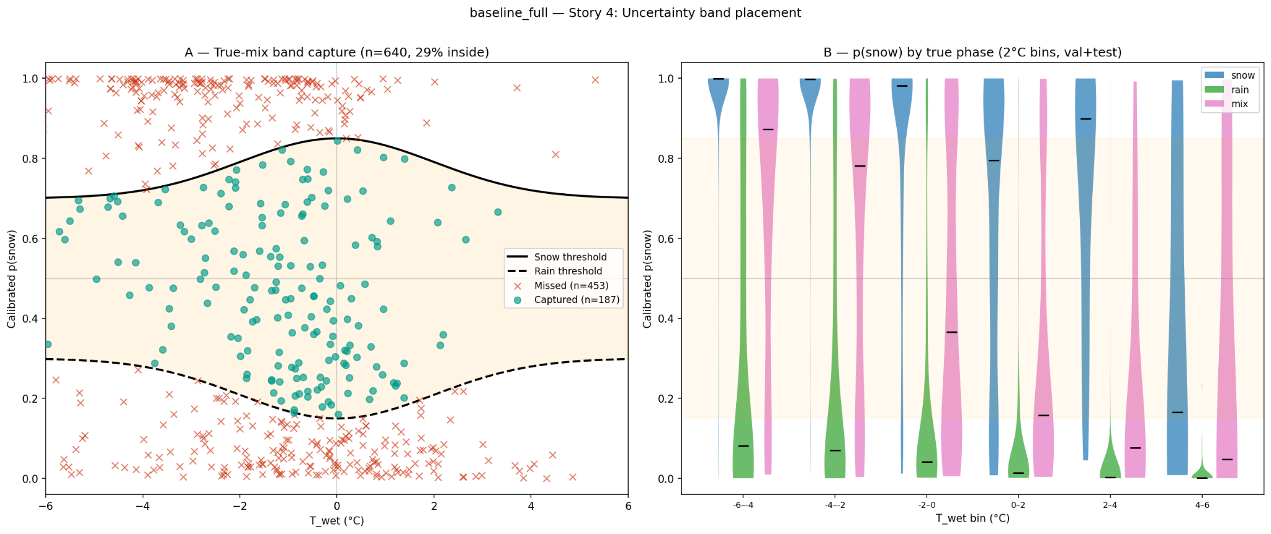
Uncertainty/”Mix” Capture by Wet Bulb Threshold (CA)
shows how the model's calibrated p(snow) is distributed for each true class (snow=blue, rain=green, mix=pink) across 2°C T_wet bins
Notes:
Model is overconfident —assigning extreme probabilities to events that are uncertain, pushing them outside the band
Most mix events are confidently assigned as either snow (p≈1, many red X's at top) or rain (p≈0, many red X's at bottom)
CA's mix events are harder → they span a wider temperature and probability range, suggesting meteorological ambiguity.
In later slide, CO's missed mix events are mostly cases where the model was confidently wrong (high p(snow) assigned to a mix event), rather than spread-out uncertainty.
Violin plots:
Snow: Extremely tight at p≈1.0 across all temperature bins, even into positive T_wet. The model is very confident about snow across the board → maybe too confident at warmer bins
Rain: Concentrated near p≈0 at cold bins, but spreads substantially as T_wet increases, showing healthy uncertainty growth at warmer temps
Mix/uncertainty: Broadly distributed across the full p(snow) range in every bin → the model assigns “mix”/uncertainty events all kinds of probabilities with no consistent center. This confirms mix events are not forming a coherent third cluster; they're scattered between the snow and rain distributions

Slide 37
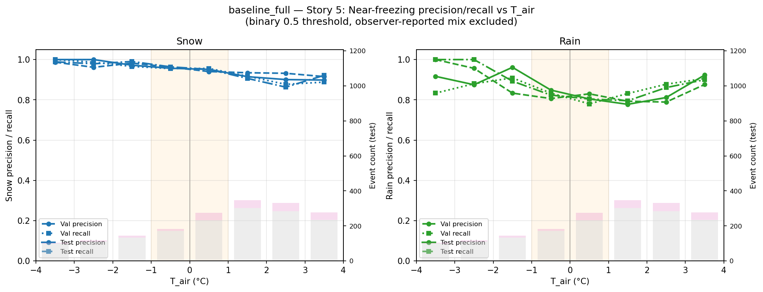
Performance Near Freezing (CA) - baseline

Slide 38
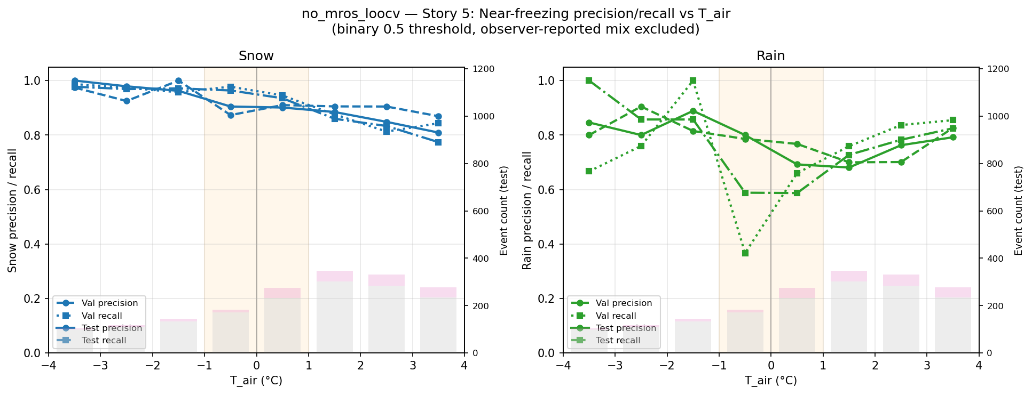
Performance Near Freezing (CA) - no MRoS

Slide 39
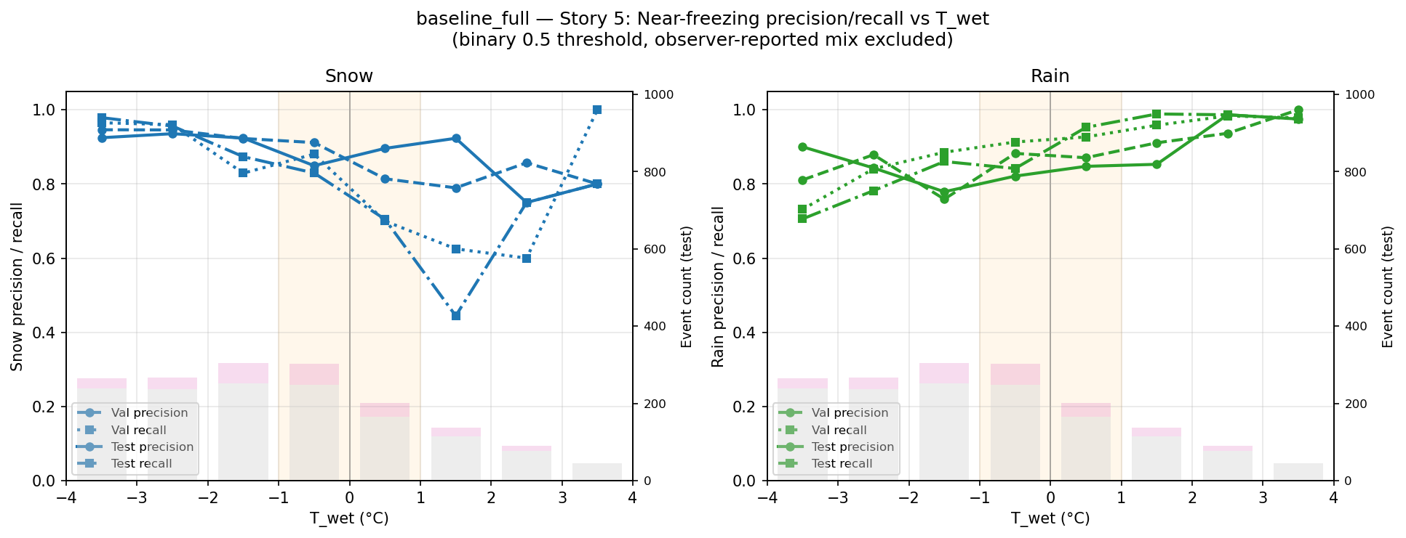
Performance Near Freezing (CA) - baseline

Slide 40
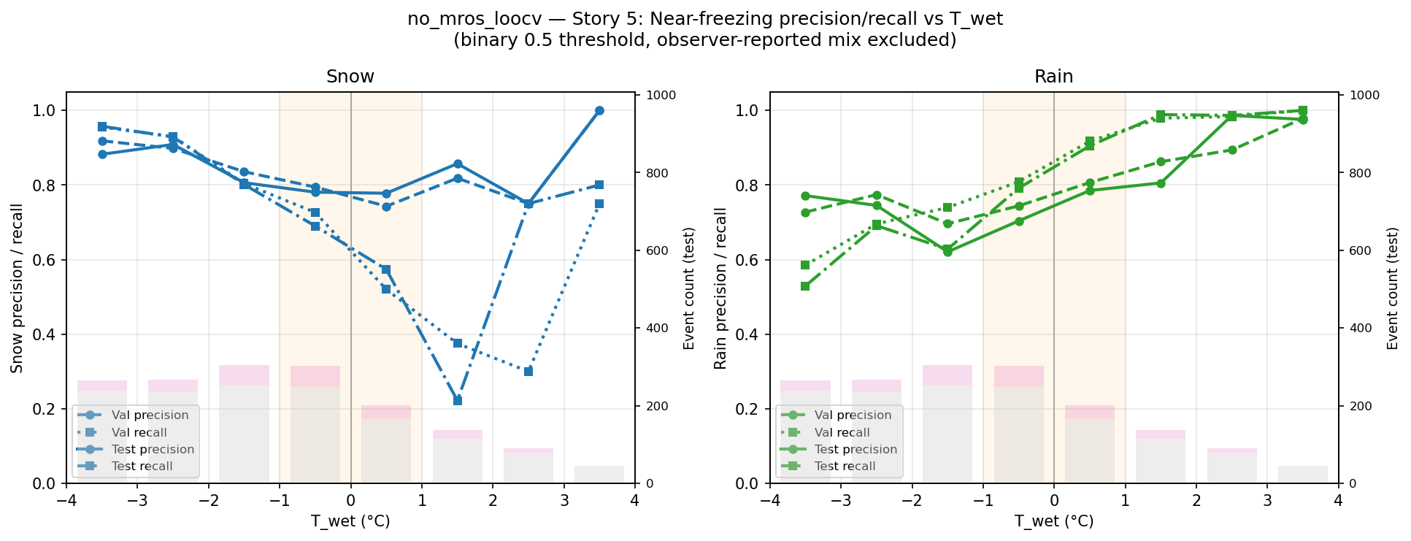
Performance Near Freezing (CA) - no MRoS

Slide 41
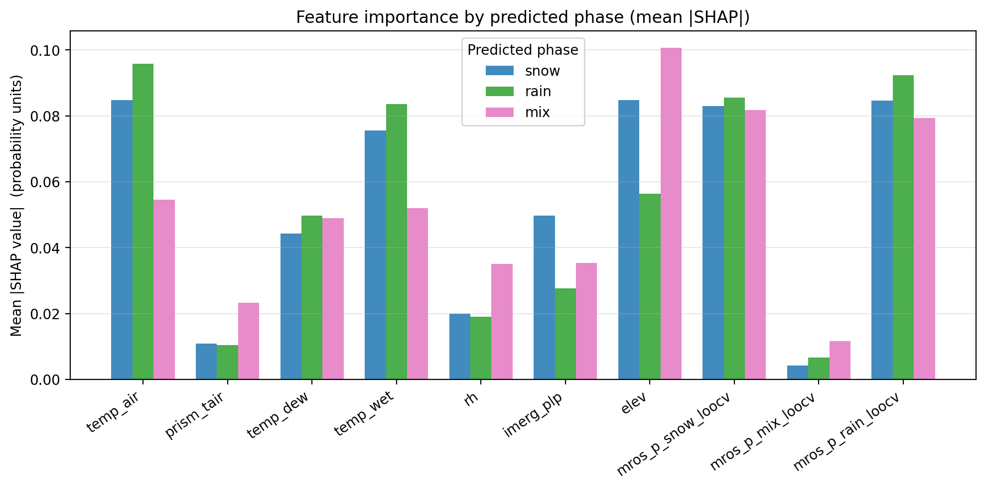
SHAP Results: Feature Importance (o.g. CA - IDW)

Slide 42
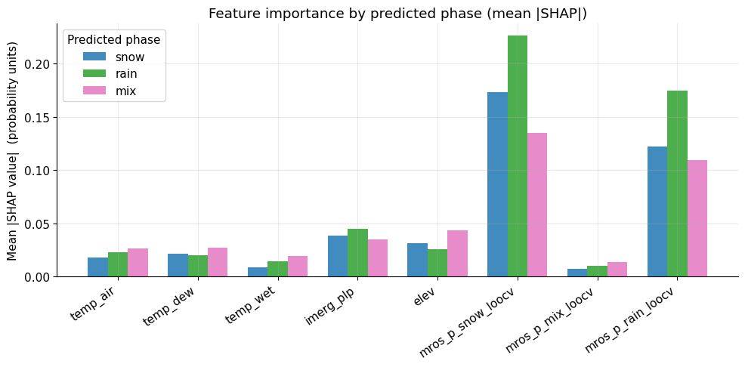
SHAP Results: Feature Importance (CA - IDW)
Notes:
Something wrong is happening with the multiregion IDW

Slide 43
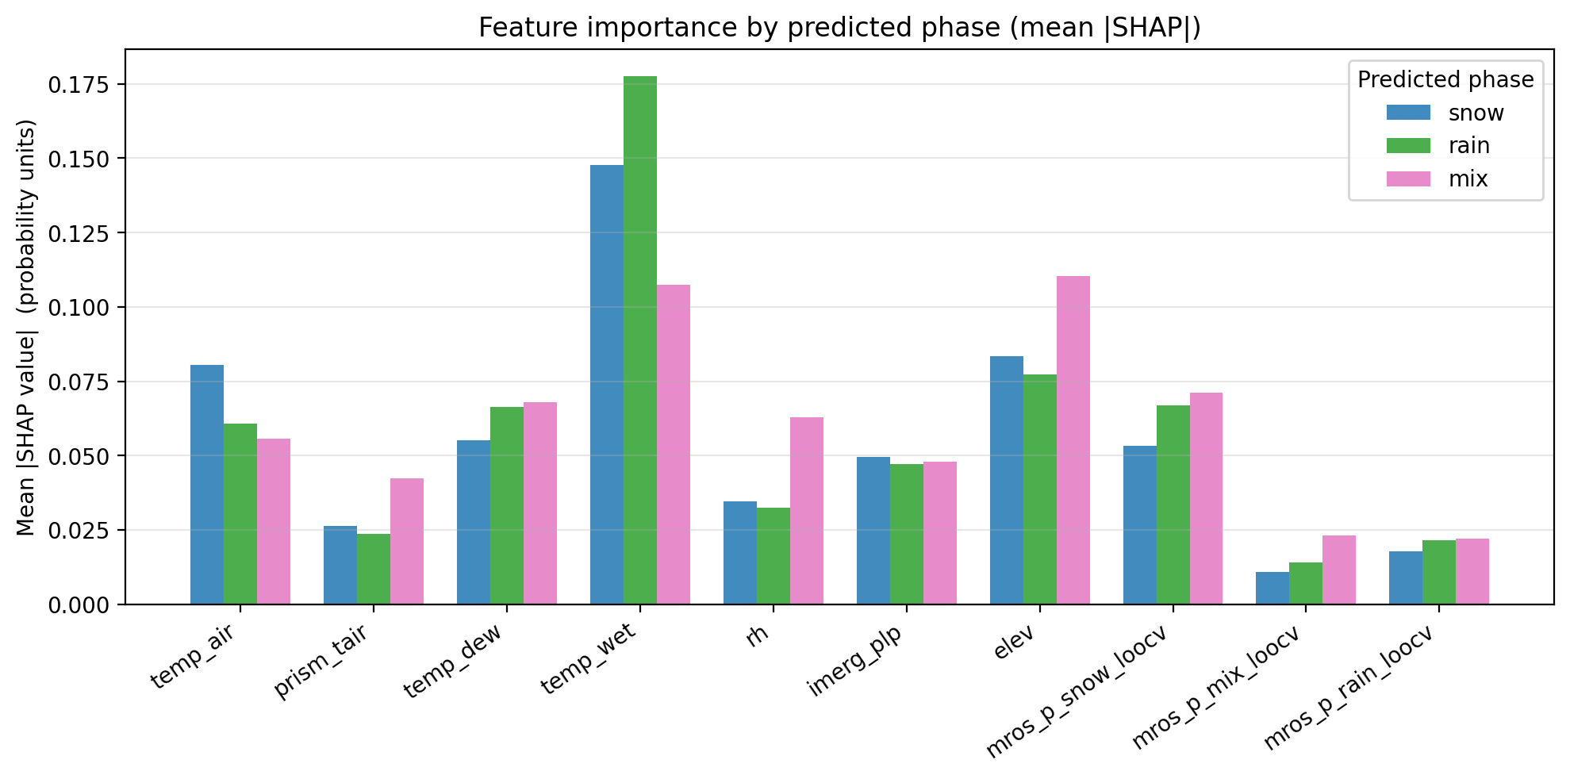
SHAP Results: Feature Importance (o.g. CA - kriging)

Slide 44
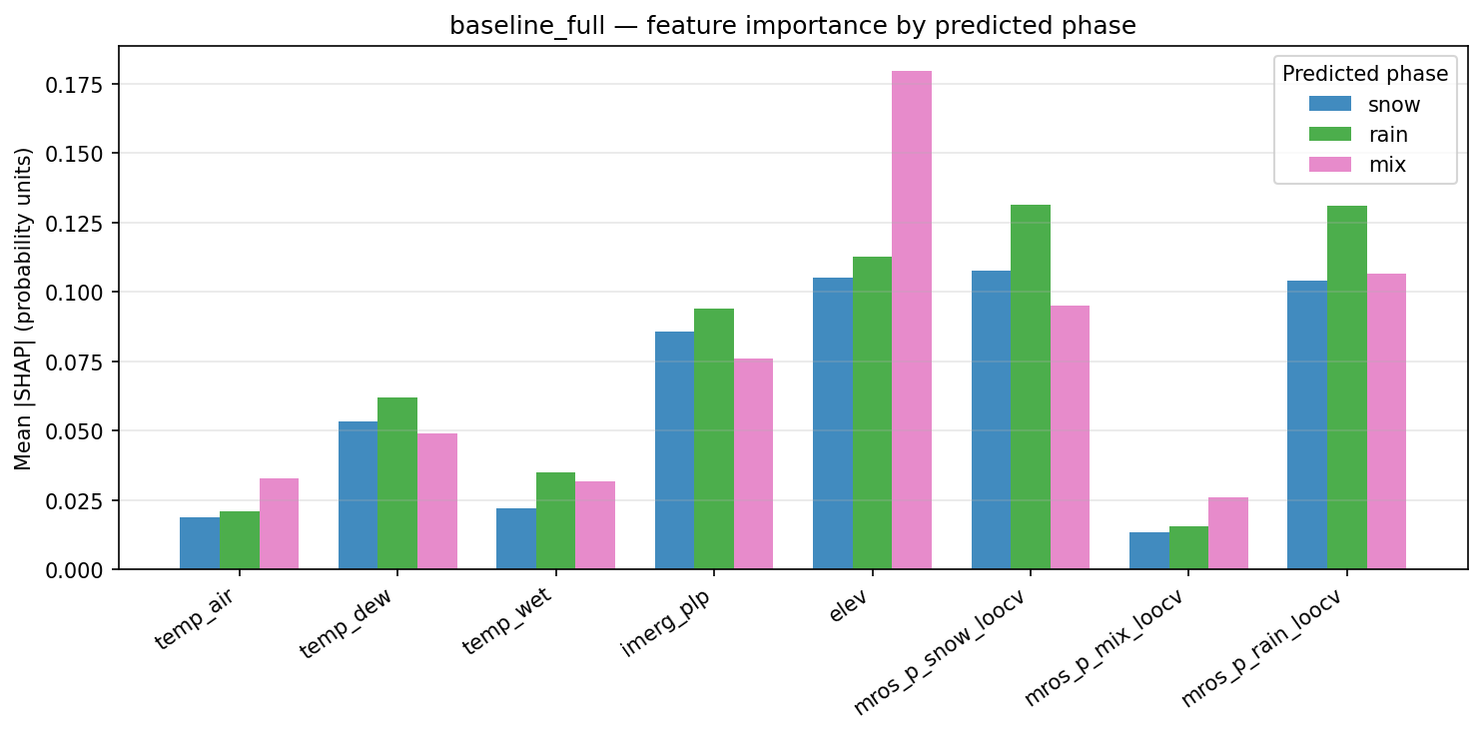
SHAP Results: Feature Importance (CA)
Notes:
Feature importance profile is balanced across features:
elev and mros_p_snow_loocv are the top two features overall (~0.105–0.13), followed closely by mros_p_rain_loocv and imerg_plp
Temperature features (temp_air, temp_wet) are surprisingly weak → among the lowest SHAP values
“Mix” predictions are dominated by elev (0.18). When the model is uncertain in CA, elevation is the primary driver, suggesting the band captures events where topographic context is most informative
Rain and snow predictions are driven by a combo of mros loocv features and elevation roughly equally
temp_dew matters more than temp_air or temp_wet for rain prediction → moisture content is more discriminating than raw temperature in CA?
Since data is imbalance, lack of rain is being overcorrected for? That’s why rain is a little higher in importance?

Slide 45
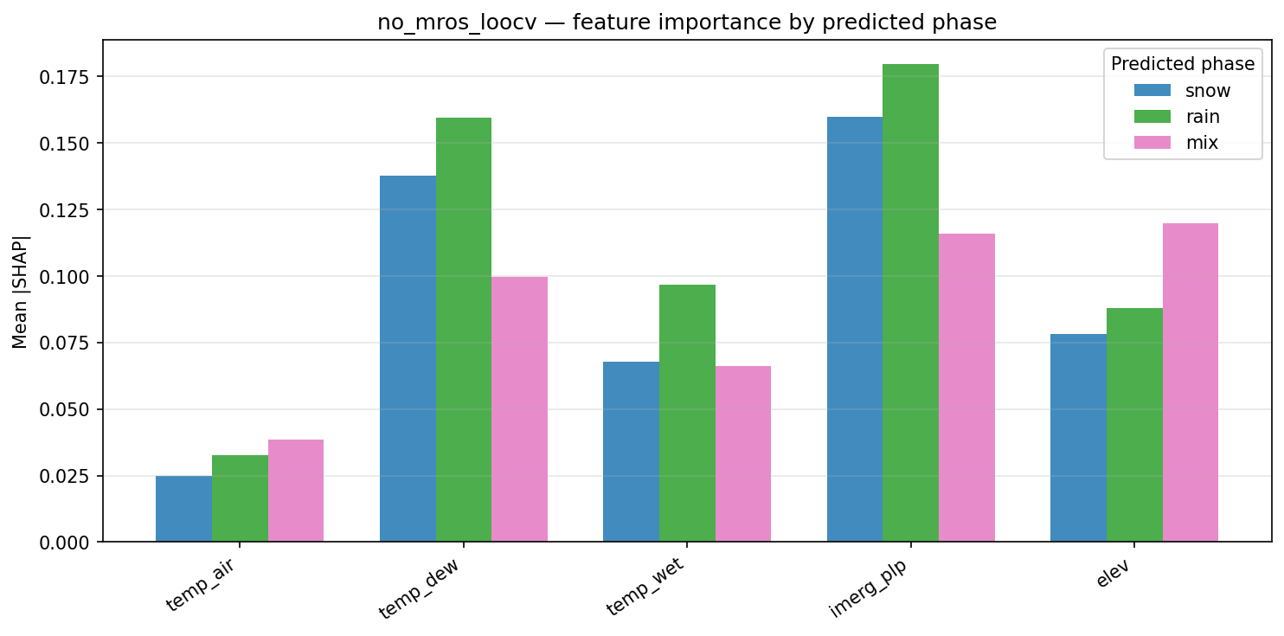
SHAP Results: Feature Importance (CA)

Slide 46
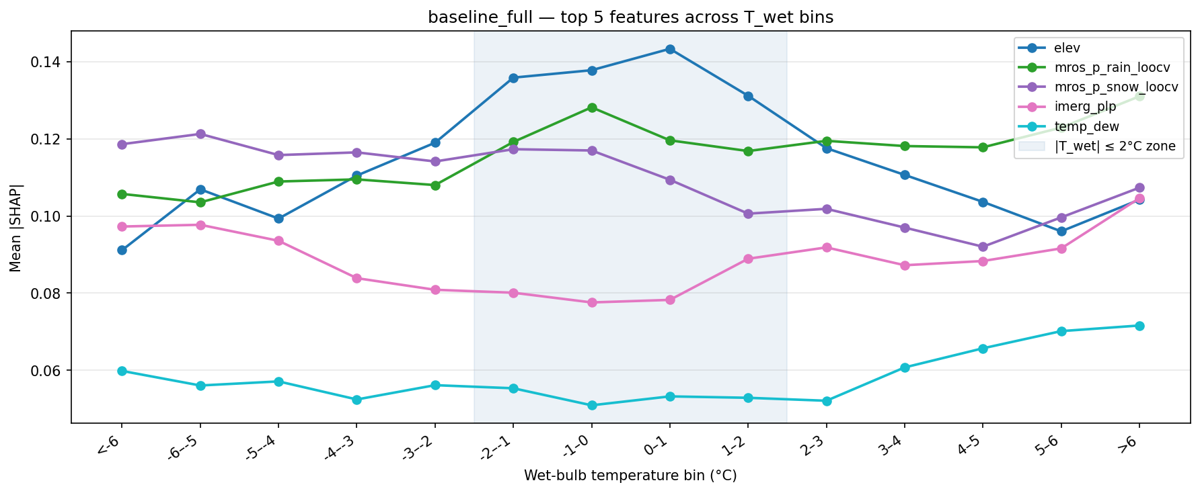
SHAP Results: Feature Importance (CA)
Notes:
elev is dominant in the transition zone (-2 to +2°C), peaking sharply at 0–1°C (~0.143) → we expect topographic effects to matter most for phase determination here
mros_p_rain_loocv rises through the transition zone and stays high at warm bins, showing rain prior kicks in as T_wet increases
mros_p_snow_loocv dominates at cold bins and falls off through the transition zone → the snow prior is most useful when it's clearly cold
imerg_plp stays relatively flat and low throughout
temp_dew is the weakest feature… why? Perhaps because SHAP on XGBoosted trees steals influence/importance from other temperature variables… issue of redundancy?

Slide 47
CA Ablation Study

Slide 48
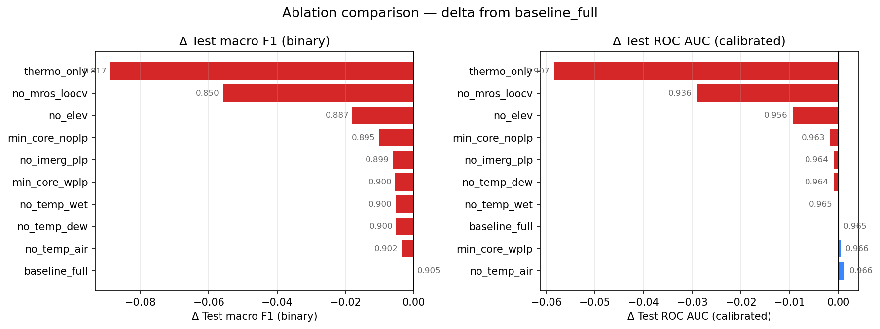
Ablation F1 and ROC Comparisons (CA)
Notes:
The F1 score measured model’s balance between precision and recall (i.e., slide 32) vs macro F1 score averages F1 scores across both class equally, regardless of class size

Slide 49
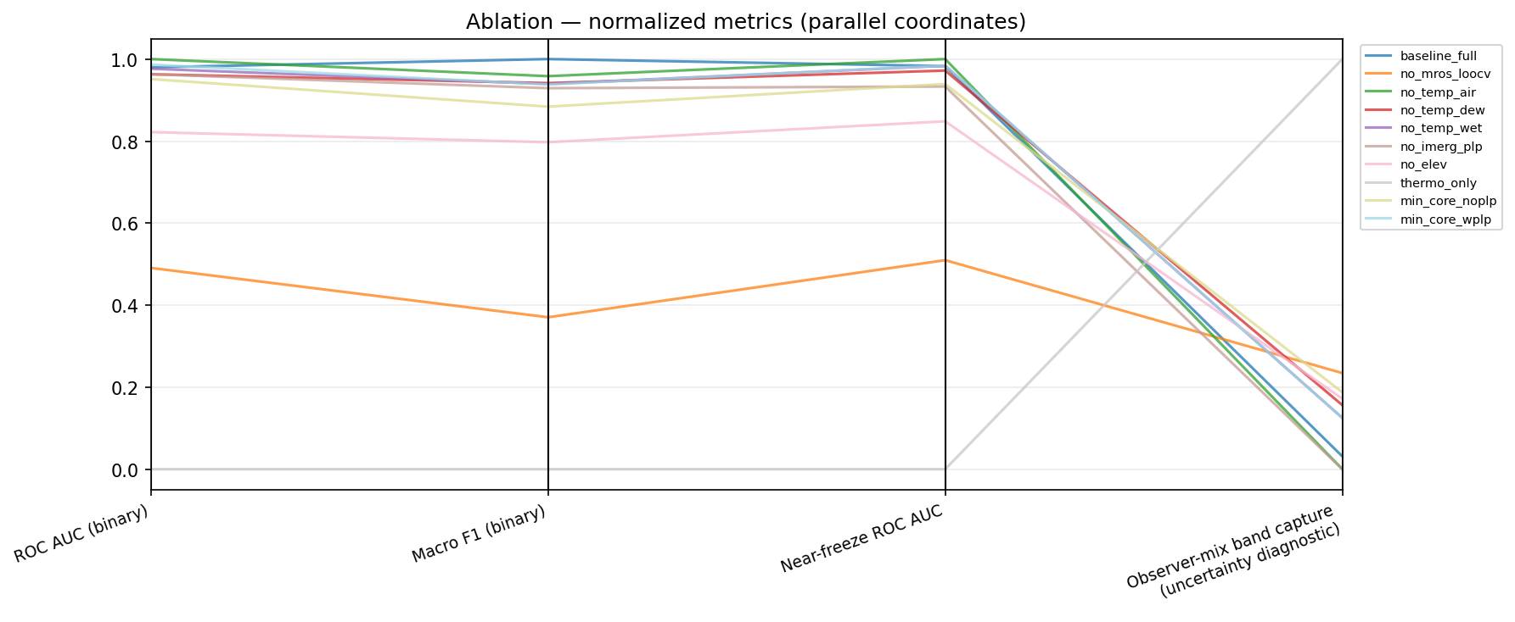
Ablation - normalized metrics (CA)

Slide 50
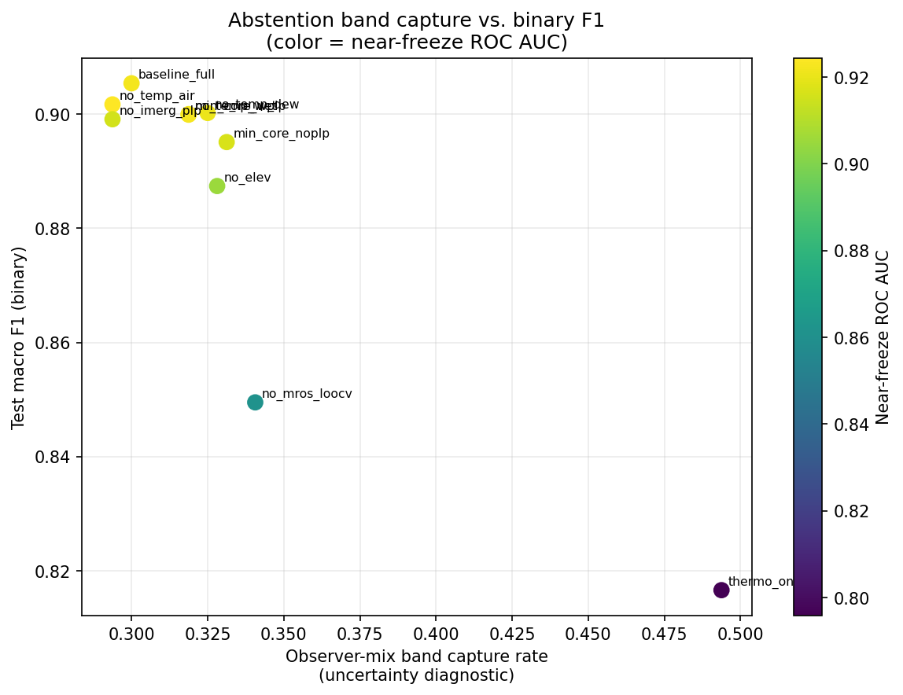
Notes:
Other graph TBA
Graph on right shows tradeoff between capture rate and macro F1

Slide 51
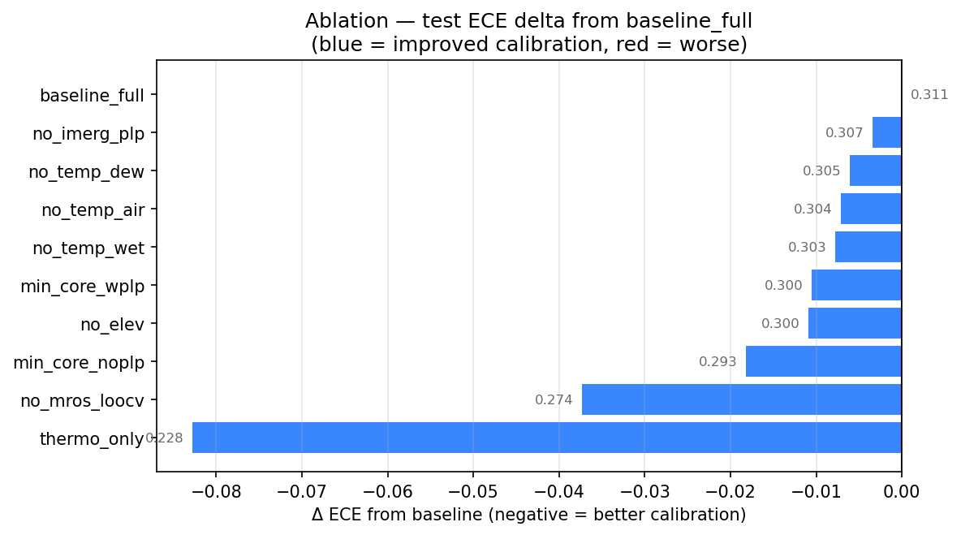
ECE Calibration
Notes:
larger negative delta means that ablation has lower ECE than baseline, so removing those features actually improved calibration
lower ECE ≠ better model; the features driving performance also drive overconfidence, let’s investigate where those features or problem cluster in CA are occuring…

Slide 52
When the model is confidently wrong: CA case study
Mean value: | Problem cluster (n=42) | Full snow population (n=9802)
mros_p_rain_loocv | 0.674 | 0.117
mros_p_snow_loocv | 0.223 | 0.786
temp_wet | -0.15C | -4.38C
elev | 1567m | 1745m
IMERG PLP | 87.5% | –
A ground observer at ~1570m elevation sees snow during a marginal event, but every other signal available to the model (the surrounding MRoS stations via LOOCV, IMERG's satellite retrieval, and the near-zero wet-bulb) is pointing toward rain. Model is making inference from imperfect inputs? This seems like a case where gridded and network data have a systematic warm/low-elevation bias relative to the MRoS point observation.
Notes:
42 CA observations (~0.2% of data) where calibrated p(snow) < 0.05 but the observer reported snow (each contributing outsized ECE penalty)
The model isn’t necessarily miscalibrated; it’s learning network consensus over a single observer. Whether the observer or the network is correct cannot be resolved from available data

Slide 53
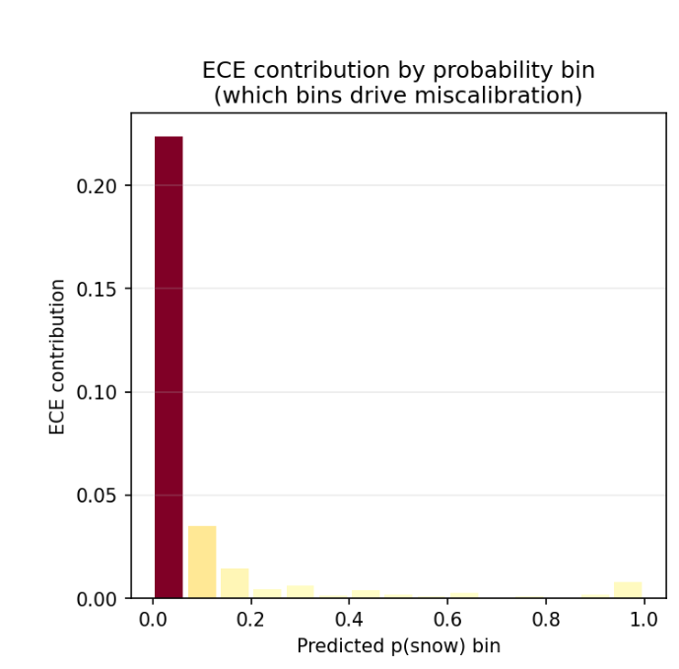
ECE penalty when the model is confidently wrong: CA case study
The model is well-calibrated for the vast majority of the observational space; the ECE inflation is driven by a small edge case at the low-elevation phase boundary where the MRoS network and gridded fields consistently disagree with the point observation.
This can be attributed to the difficulty of citizen science phase observations, possible human error, and or genuine corrections by human observers on biased station / temperature predictions

Slide 54
Discussion on ECE inflation and citizen science obs
When a citizen observer is at a lower-elevation site during a marginal event, they may be capturing a real orographic or micrometeorological snow signal that the surrounding station network misses
The freezing level can drop extremely rapidly with elevation over very short distances in the Sierra Nevadas, (i.e., during atmospheric river events) and a single observer at 1570m may be in snow while stations at 1400m nearby are in rain.
The LOOCV surface spatially interpolates across that gradient and comes out rain-dominant.
IMERG compounds this because its retrieval is weighted toward the lower, warmer surrounding cells.
The model then learns to trust the LOOCV surface for the general case → but in these edge cases, the individual citizen observer is the only instrument actually located at that elevation, in that microclimate, at that moment
In a way, the citizen science observations are a form of ground truth that reveals the limitation of everything else

Slide 55
Discussion on ECE inflation and citizen science obs
The ECE inflation in the low-p(snow) bin is concentrated at lower-elevation boundary sites during marginal events → observational gap that motivates citizen science networks like MRoS in the first place.
The model's miscalibration in this regime is a direct reflection of the sparse conventional network, not modeling failure
75% of the p≈0 cluster is genuinely snow (per the observer) despite all gridded signals pointing to rain → evidence that MRoS observers are providing physically meaningful, non-redundant information about phase at locations and elevations that conventional networks don't sample
Calibration degrades for low-elevation boundary sites during near-freezing marginal events where the LOOCV surface is rain-dominant
expected consequence of spatial interpolation across steep orographic gradients, not a systematic model bias?

Slide 56
Results
Binary Model on CO
(kriging-based interpolated MRoS and station predictors)

Slide 57
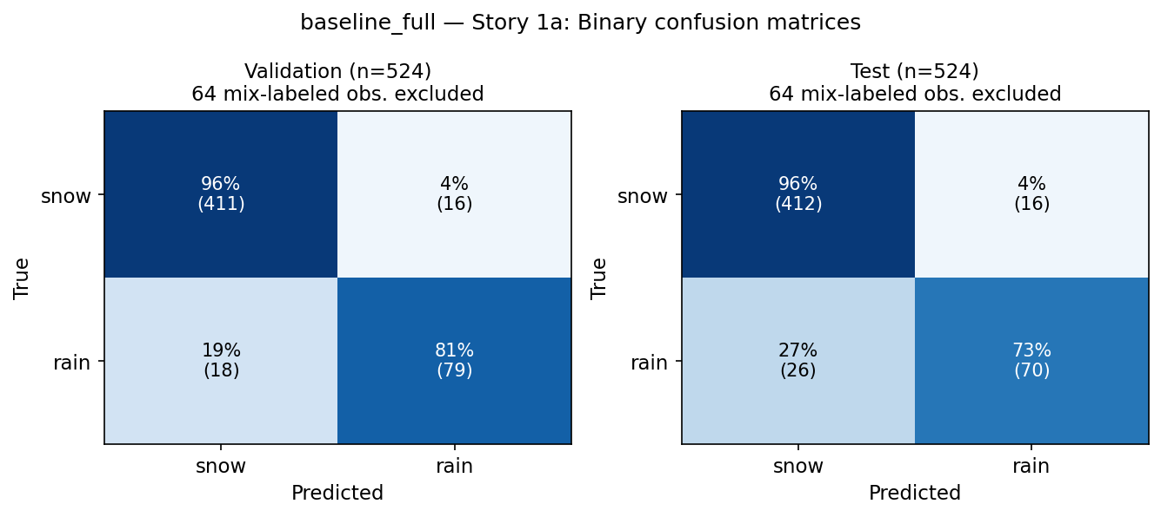
Confusion Matrices
Notes:
Remaining snow bias, even after class imbalance handling; most observations in the dataset are snow.

Slide 58
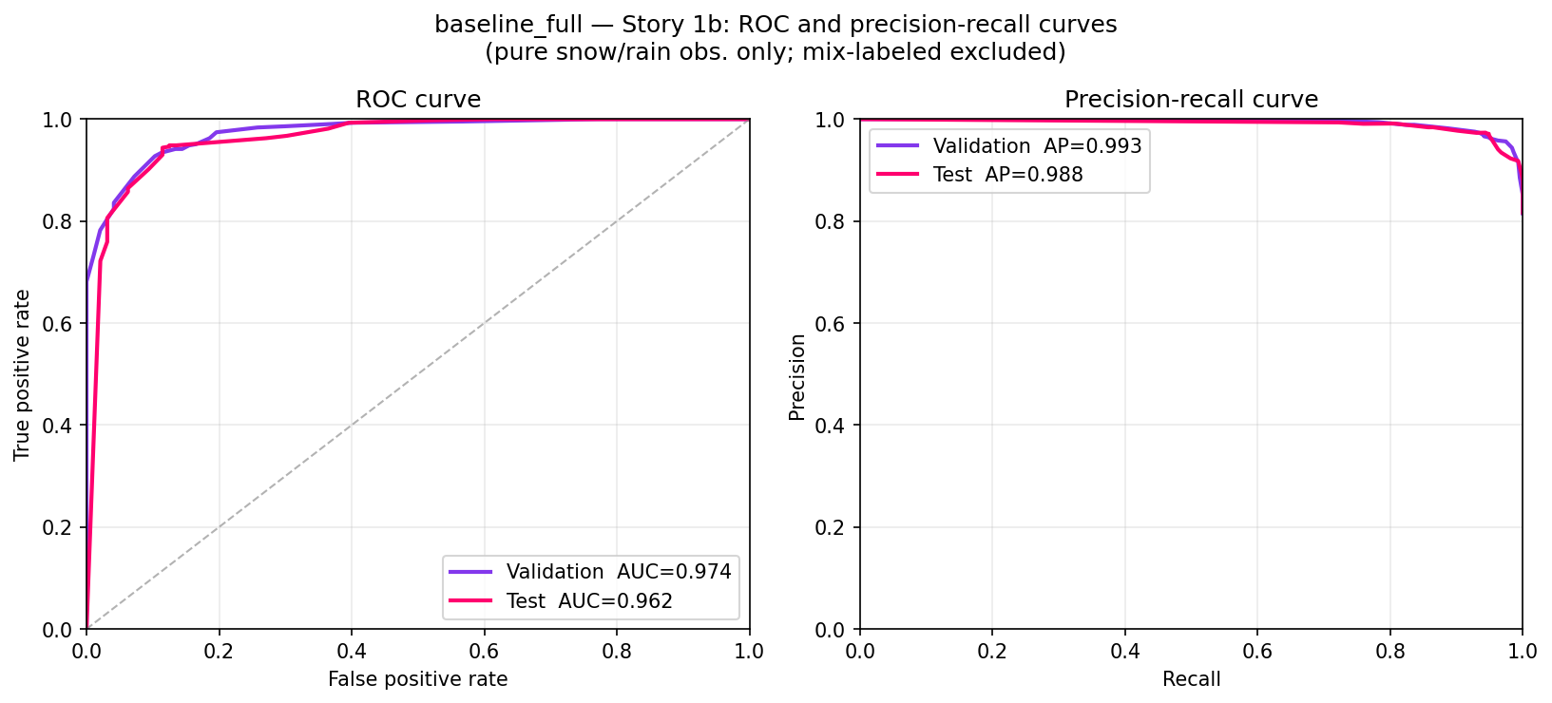
AUROC, AP
Notes:
Why the near 1.0 nature in PR curve?

Slide 59
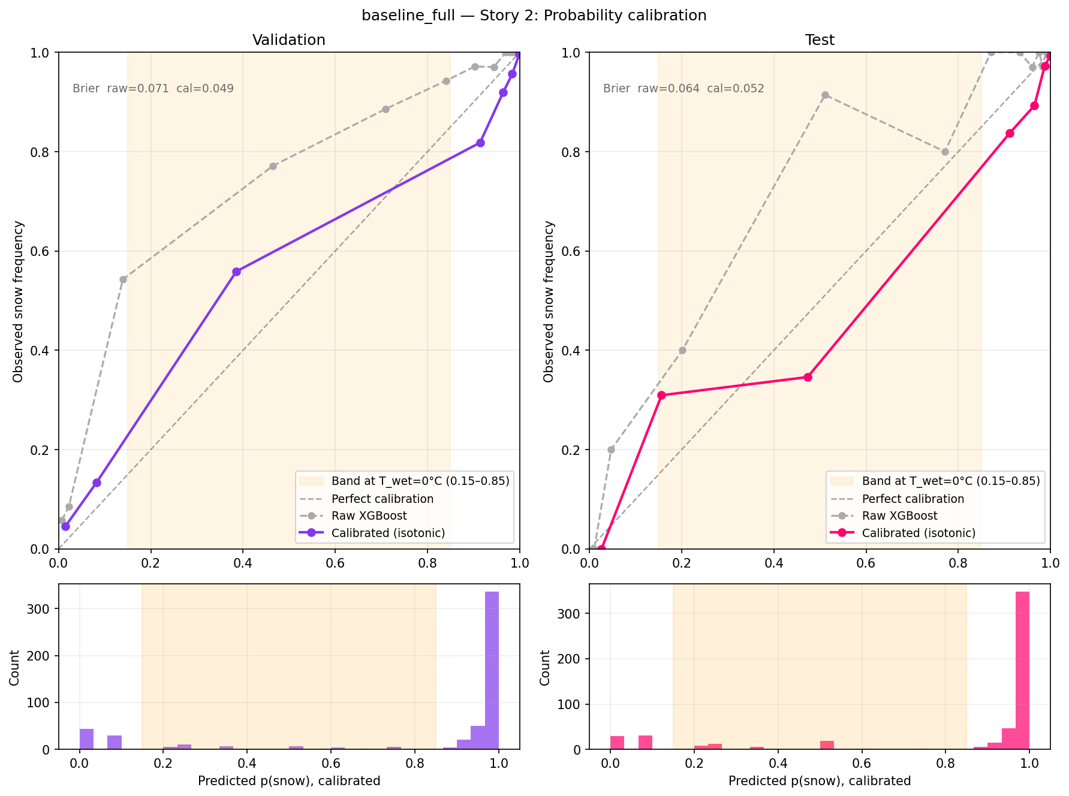
Isotonic regression on sparser CO dataset.
Calibration pulls raw XGBoost scores closer to diagonal line of perfect calibration.
Miscalibration still exists on p(snow) extremes even after calibration.
But low brier scores indicate strong accuracy overall.

Slide 60
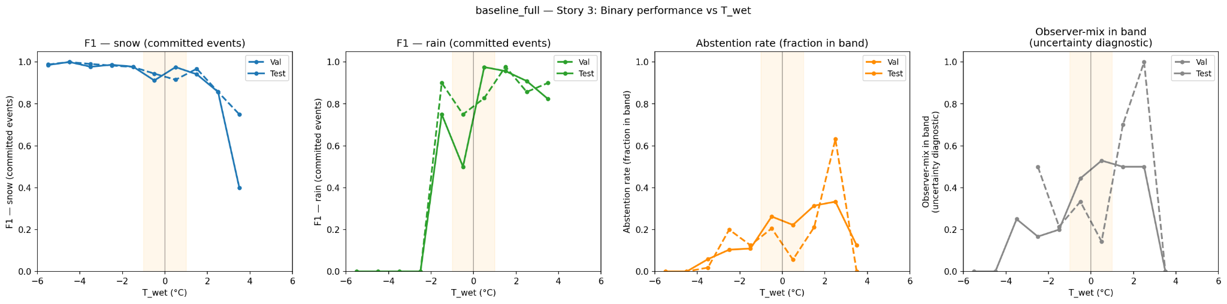
F1 Accuracy vs Wet Bulb Temperature (CO)
Fraction of true "mix" events the model places in the mix band → measures whether the model's uncertainty is calibrated to the right temperature range.
Strong performance at cold temperatures below -4°C, then a steady degradation as T_wet approaches 0°C and above. Sharp drop off in both val and test accuracies after 2°C.
CO degrades more sharply above freezing than CA’s transition zone.
Rain F1 is 0 below -2°C (no rain at those temps), then rises steeply but noisily through the transition zone. Val reaches ~0.9 near 0°C but oscillates. Test is consistently lower and more erratic than val.
overlap between "model uncertain" and "observer reported mix" is weak
Incoherent, val/test diverge a lot; model doesn’t quite know where it should be uncertain here.

Slide 61
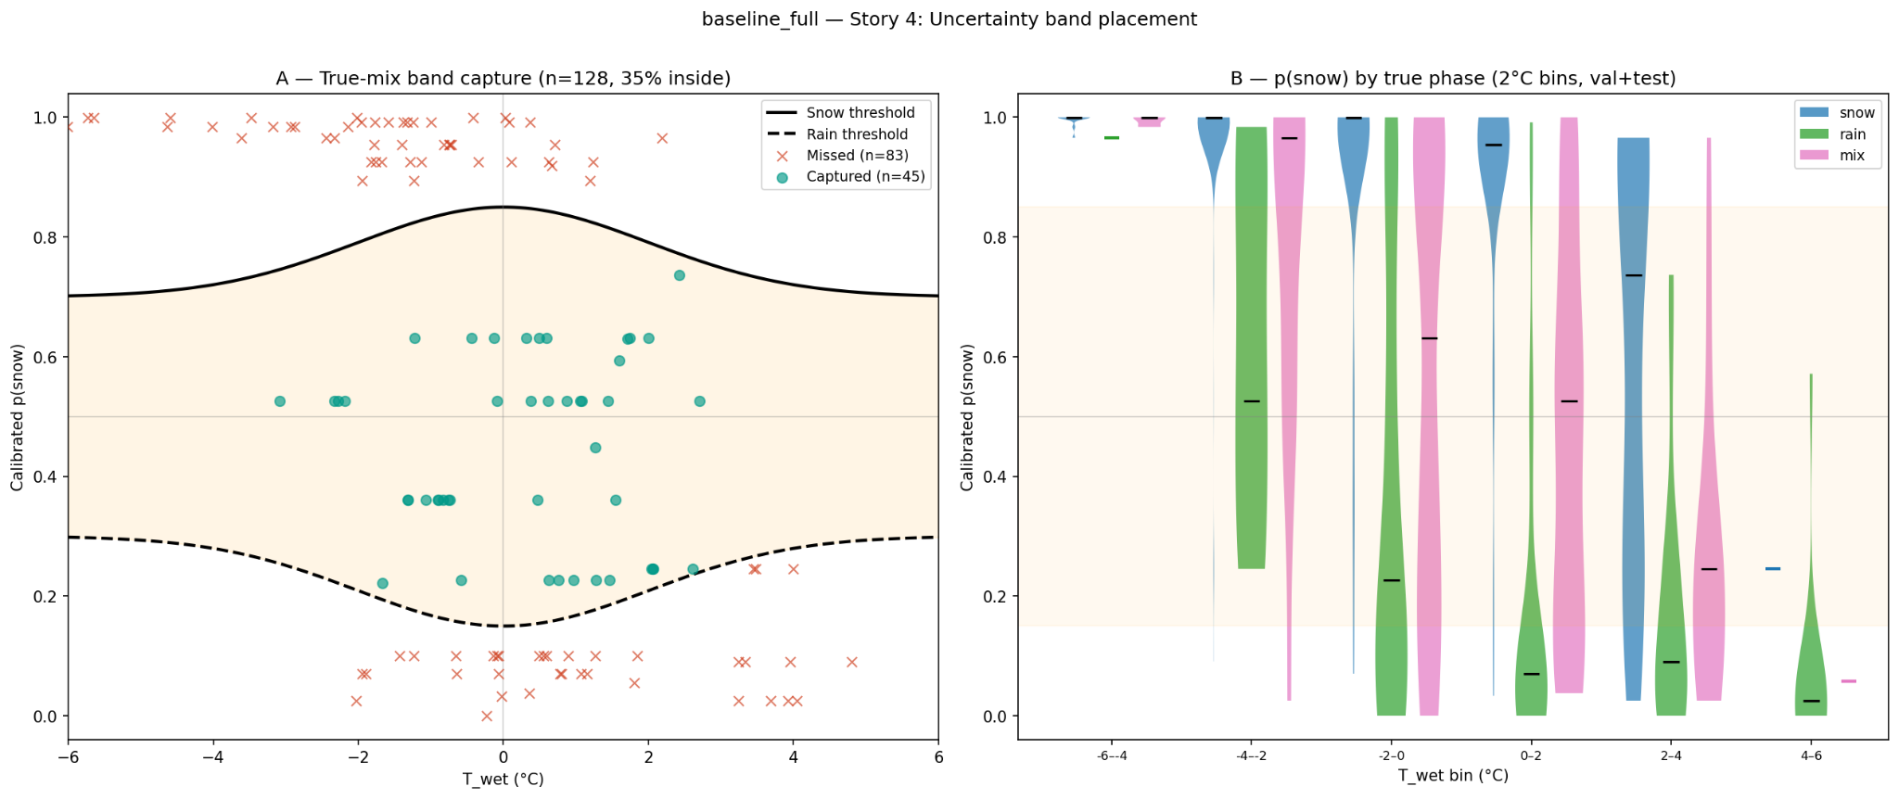
Uncertainty/”Mix” Capture by Wet Bulb Threshold (CO)
Are we appropriately optimizing the wet-bulb thresholding band for mixed phase?
Notes:
Far fewer mix events total → CO doesn't generate many ambiguous cases
Capture rate is slightly better than CA (35% vs 29%)
Nearly all the missed red X's sit at p>0.8 or p<0.2 → again model is overconfident, but captured dots are much more tightly clustered near p=0.5–0.65 and T_wet -1 to +2°C
The band placement looks more appropriate for CO's actual mix distribution
Violin plots:
Snow (blue): Also tight near p=1.0 in cold bins, but notably the distribution widens and drops in the +2–4°C and +4–6°C bins → the model knows it's less certain about warm snow in CO, which is good calibration behavior
Rain (green): Much wider distributions than CA at all temperature bins, especially -4 to +2°C. Rain in CO spans from p=0.2 to p=0.9 in the transition zone → the model struggles to separate rain from snow there
Mix (pink): In CO, mix distributions are narrower and more centered around p=0.5–0.7 in the transition bins (0–2°C, 2–4°C), suggesting the model's uncertainty is better targeted to the right temperature range, even if capture rate is still low

Slide 62
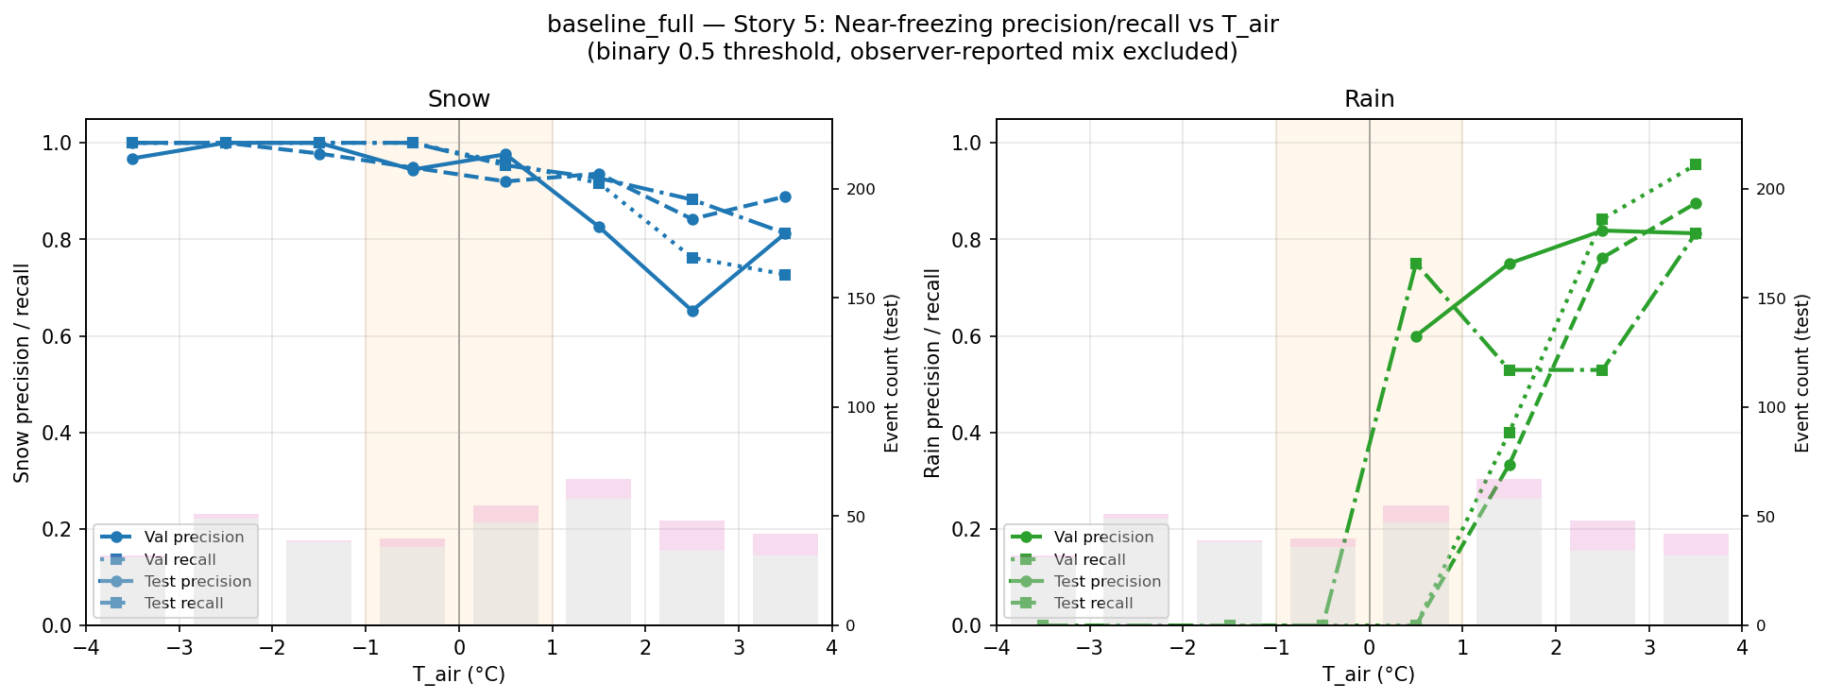
Performance Near Freezing (CO) - baseline

Slide 63
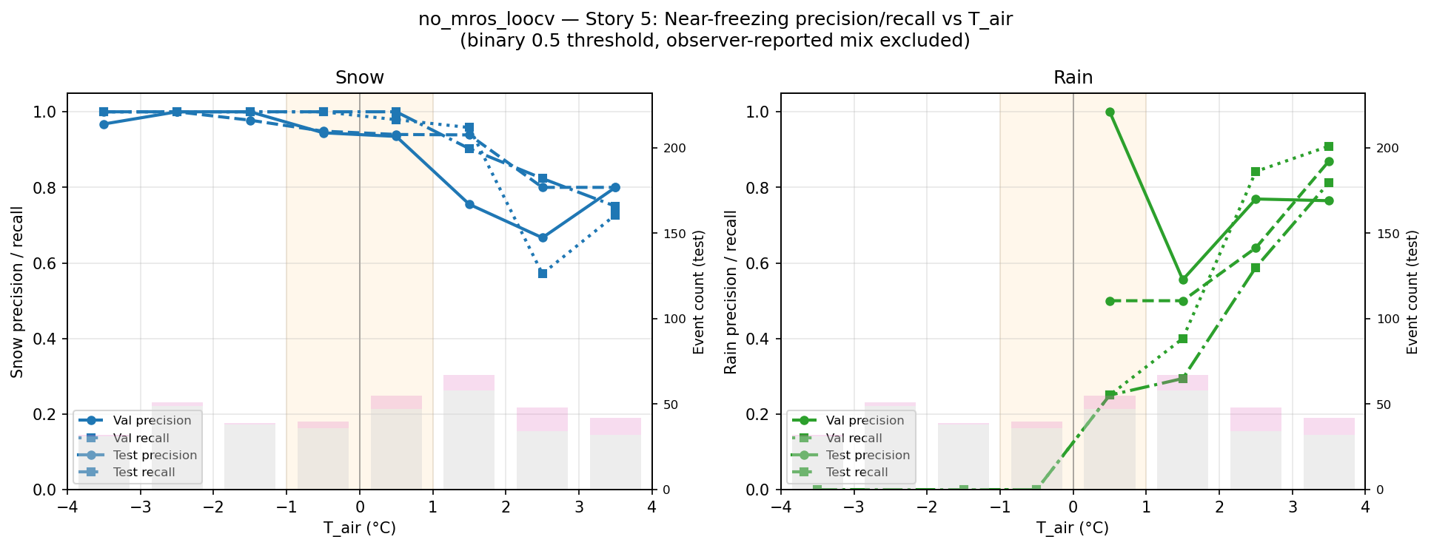
Performance Near Freezing (CO) - no MRoS

Slide 64
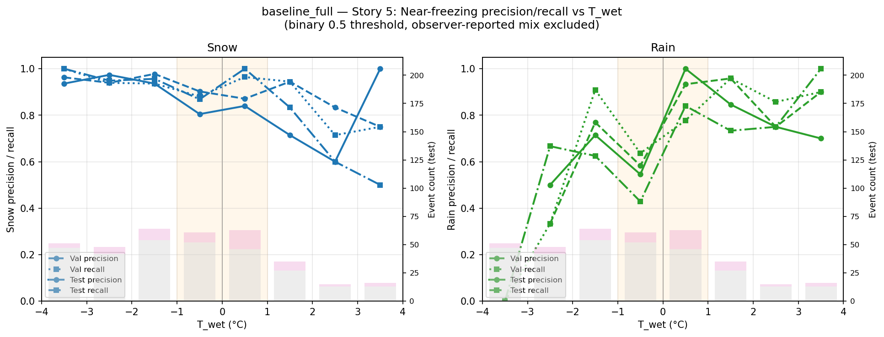
Performance Near Freezing (CO) - baseline

Slide 65
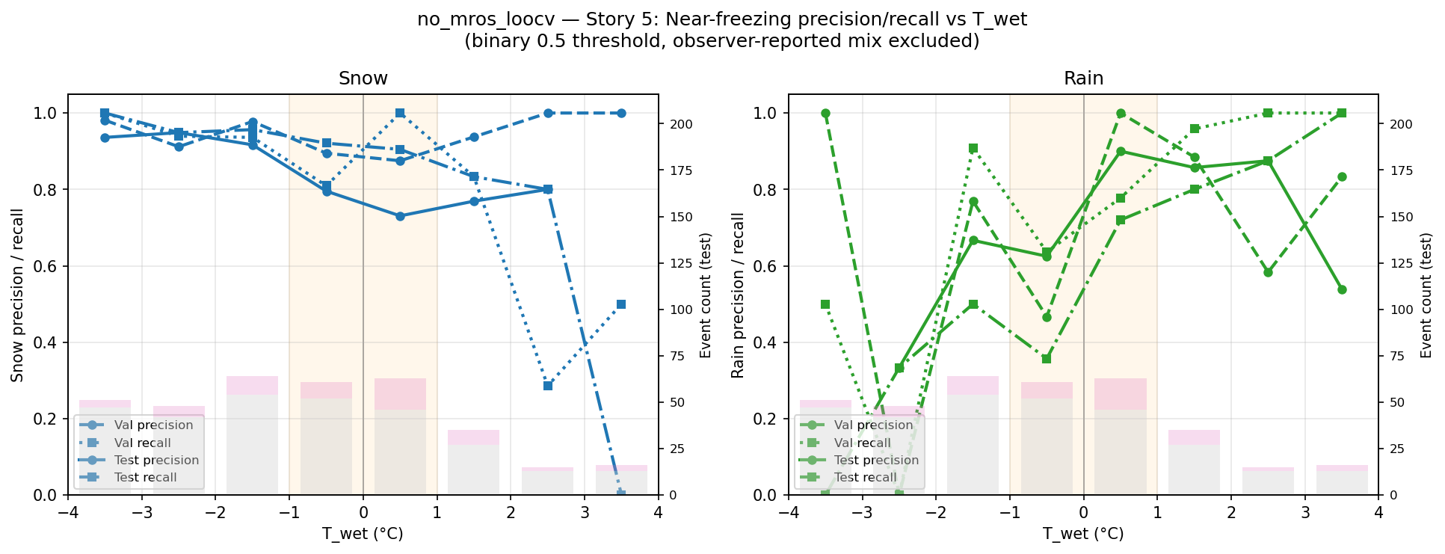
Performance Near Freezing (CO) - no MRoS

Slide 66
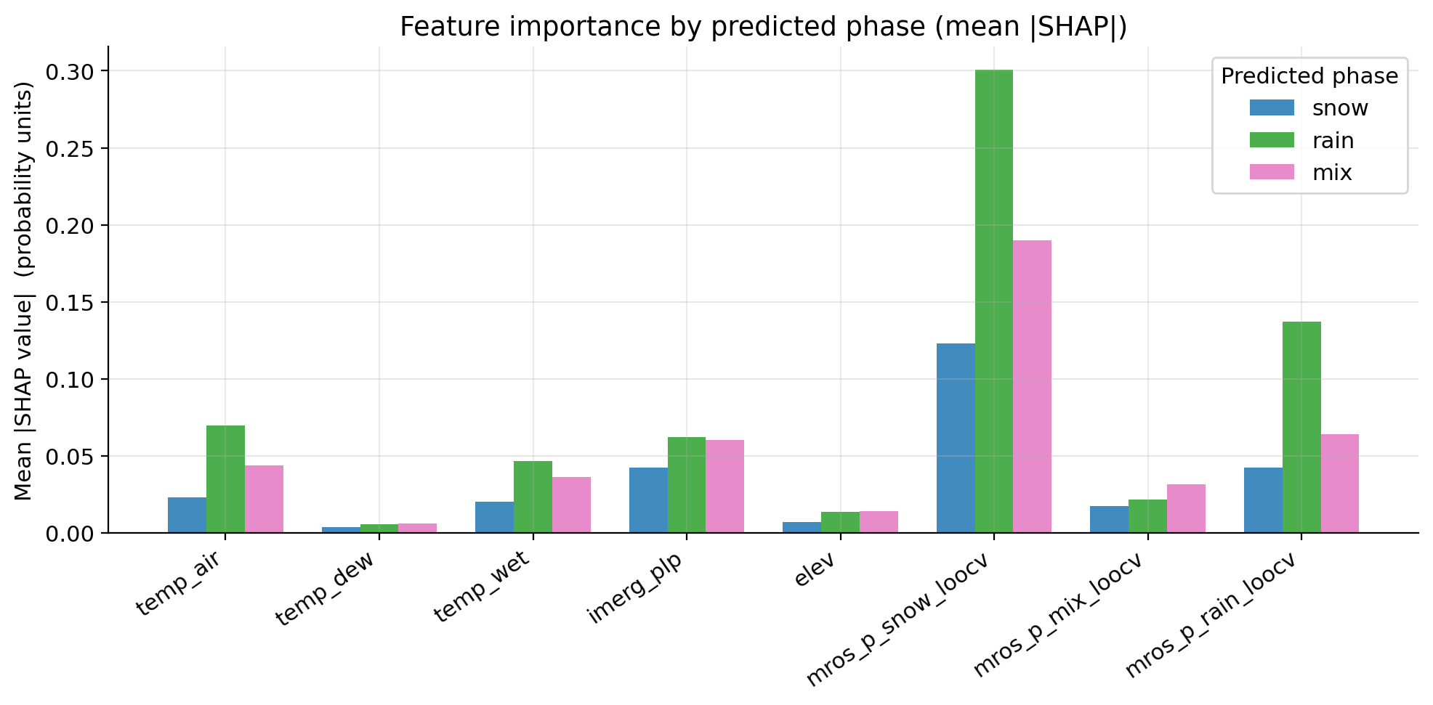
SHAP Results: Feature Importance (CO-IDW)
Notes:
Something wrong was happening with the multiregion IDW…

Slide 67
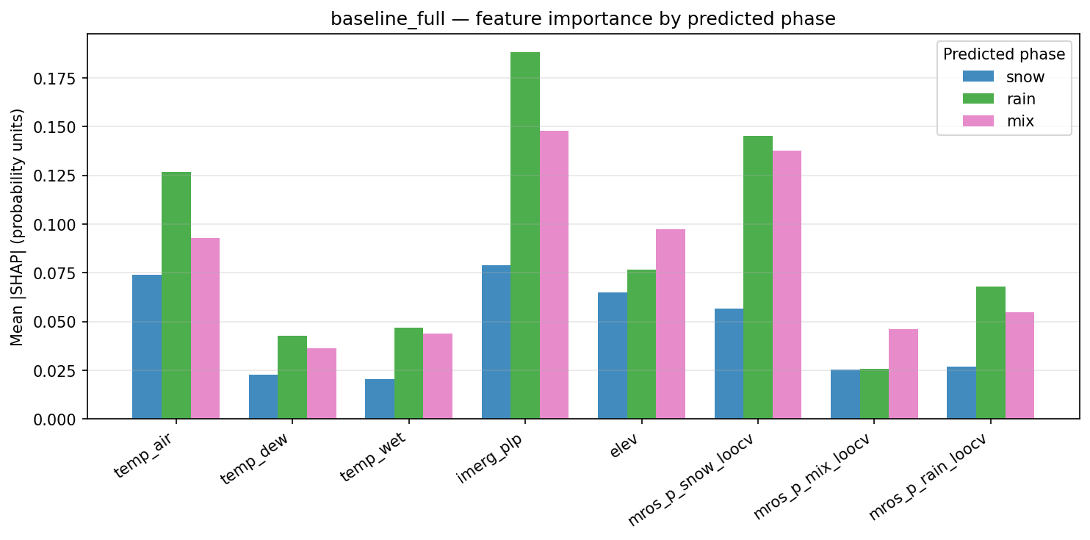
SHAP Results: Feature Importance (CO-kriging)
Notes:
imerg_plp is the dominant feature overall, and especially for rain (~0.19) and mix (~0.15) → precipitation amount is far more important in CO than CA
mros_p_snow_loocv is the second most important, especially for rain and mix (~0.145)
temp_air matters much more in CO than CA, especially for rain (~0.13) and mix (~0.095) → CO actually uses temperature
elev is relatively weak (~0.065–0.098) compared to CA where it dominated
mros_p_rain_loocv and mros_p_mix_loocv are low across all phases → the model has weak rain/mix climatological priors in CO, consistent with those being rare events
Snow predictions are curiously low on almost everything → the model is confident about snow without needing strong feature signals

Slide 68
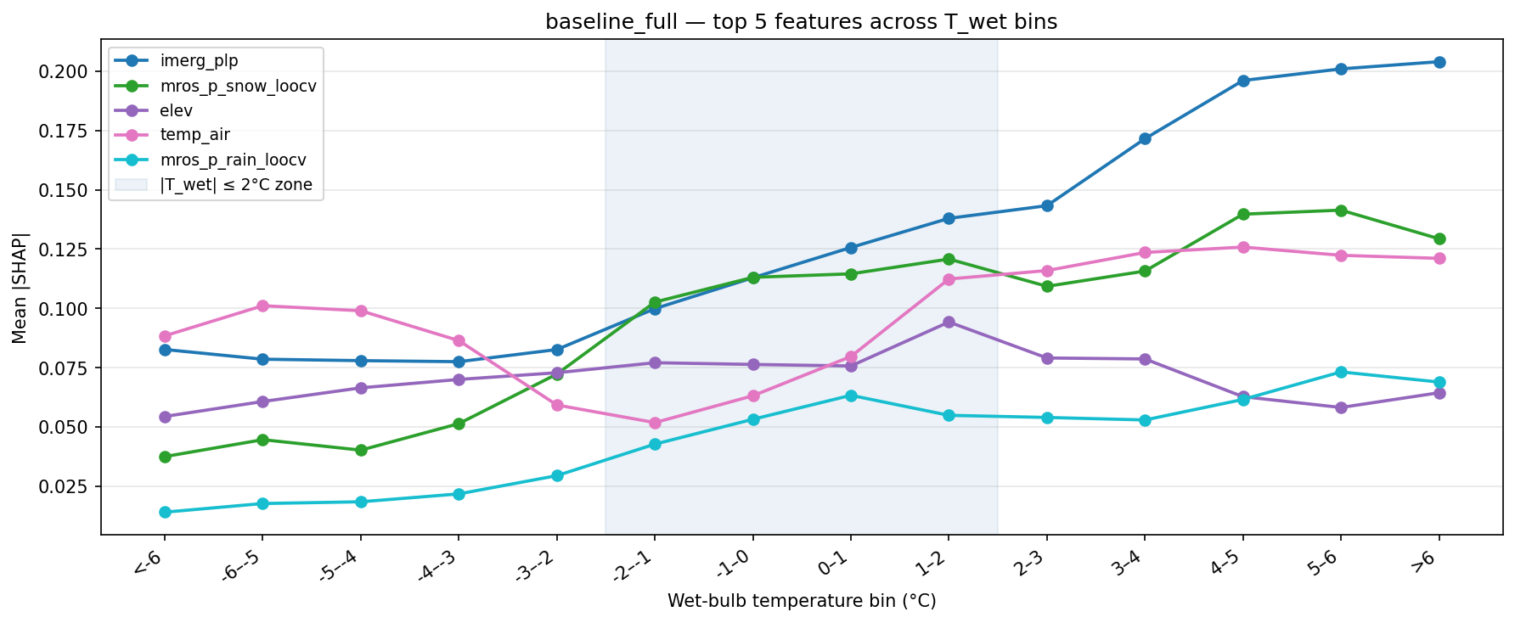
SHAP Results: Feature Importance (CO-kriging v2)
Notes:
imerg_plp starts moderate at cold bins (~0.08) and rises through the transition zone, reaching ~0.20 at warm bins (>6°C). This is unlike anything in CA – precipitation amount becomes the dominant signal at warm temperatures
mros_p_snow_loocv rises sharply entering the transition zone (-2 to 0°C, reaching ~0.12) and stays elevated → snow climatological prior
elev stays flat and relatively low (~0.07–0.095) throughout → elevation doesn't carry special importance in CO's transition zone the way it does in CA
temp_air is actually highest at cold bins (~0.10) and dips in the transition zone before recovering → it helps confirm cold snow but is less useful at the boundary
mros_p_rain_loocv stays low everywhere (~0.015–0.075), confirming the model has little rain prior to draw on

Slide 69
CO Ablation Study

Slide 70
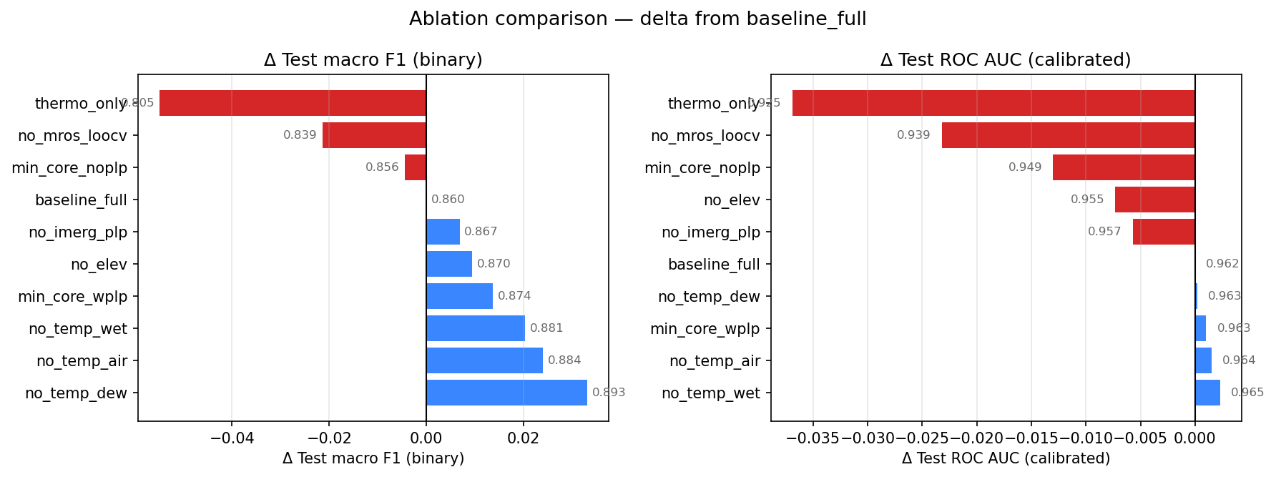

Slide 71
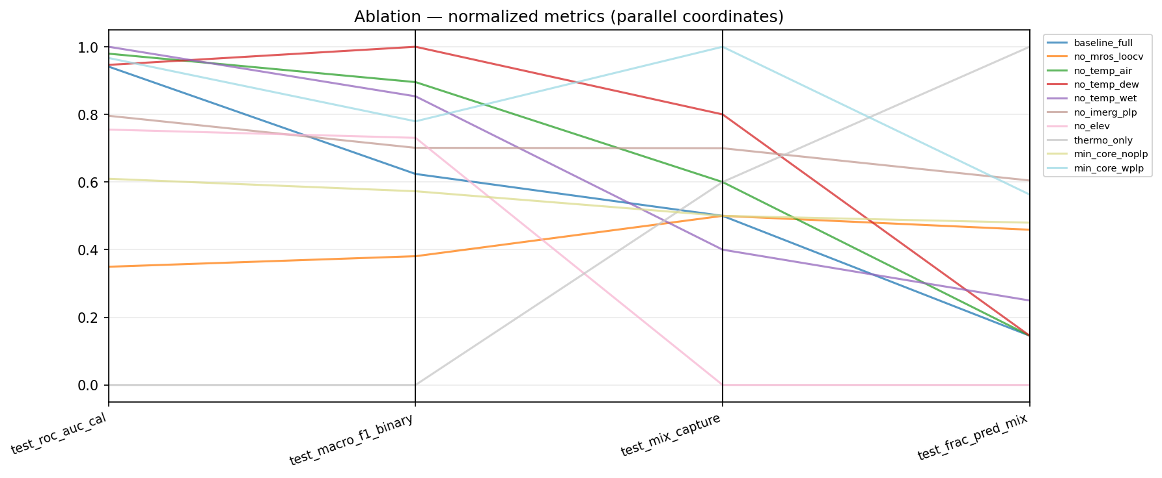
Ablation - normalized metrics

Slide 72

Notes:
Other graph TBA

Slide 73

ECE Calibration

Slide 74
Summary

Slide 75
Summary of Results: CA
California (binary model, kriged predictors, beta calibration)
The model classifies pure rain/snow well: 92% snow recall and 89% rain recall on both validation and test (n=2,301 each, 320 mix-labeled obs excluded), with test AUC 0.965 and AP 0.978.
Beta calibration on the large, bimodal CA dataset pulls raw XGBoost scores toward the diagonal, though miscalibration persists at the p(snow) extremes; Brier scores stay low (~0.07).
F1 vs. wet-bulb temperature shows snow accuracy is strong in clear-phase regimes but dips sharply near freezing (lowest around ~1.5°C) and again above 4°C, while rain F1 improves monotonically with temperature and generalizes tightly between val and test.
The abstention rate peaks near 0°C – the model sort of knows where to be uncertain – but the band captures only 29% of true observer-reported mix events.
SHAP shows the MRoS LOOCV surfaces (p_snow, p_rain), elevation, and IMERG PLP dominate, with elevation especially important inside the |T_wet| ≤ 2°C zone.
Ablation shows that dropping MRoS LOOCV surfaces costs the most F1 (0.905 → 0.850) after thermo_only (0.817), while individual temperature features are nearly redundant.
The ECE case study is interesting for CA: a 42-observation cluster of low-elevation (~1570m), near-freezing snow events drive most of the calibration penalty because every gridded signal points to rain while observers report snow → shows that citizen observations carry non-redundant ground truth in the regime where conventional networks under-sample

Slide 76
Summary of Results: CO
Colorado (binary model, kriged predictors, isotonic calibration)
Snow performance is really good (96% recall), but rain degrades from 81% (val) to 73% (test) on a much smaller sample (n=524, only ~96 rain obs), reflecting CO's snow-dominated, sparser dataset.
AUC remains high (0.962 test) and isotonic calibration improves Brier (0.064 → 0.052), but the reliability curve is noisy in the mid-range.
F1 vs. T_wet degrades more gradually and monotonically than CA's, but rain F1 is erratic with notable val/test divergence, and the mix-band diagnostic is incoherent → the model doesn't reliably localize its uncertainty.
Band capture of true mix is 35%.
SHAPfor CO differs sharply from CA: mros_p_snow_loocv and imerg_plp dominate, with IMERG importance rising steeply at warmer temperatures
The CO ablation is interesting in that removing temperature features improves F1 (no_temp_dew is the best configuration at 0.893 vs. 0.860 baseline), suggesting interpolated temperatures inject noise in this sparser network?

Slide 77
Summary of Results: CA vs CO
Cross-region takeaways
Assimilated predictors beat thermodynamics-only everywhere, but for complementary reasons:
CA: citizen-science surfaces are the load-bearing feature; removing MRoS LOOCV is the most damaging ablation
CO: satellite IMERG PLP fills the sparse-network gap; removing IMERG PLP is among the most damaging while interpolated temperatures add noise in the sparse network
a minimal four-feature core nearly matches the full model
the mix band works as an operational abstention flag (right temperature regime, at least in CA) but not as a mixed-phase detector
captures 29% (CA) / 35% (CO) of observer-reported mix, but abstention rate correctly peaks near 0°C in CA
near-freezing prediction remains hard regardless of feature set
surface predictors cannot resolve hydrometeor melting/refreezing, which is governed by the atmospheric column
Apparent miscalibration is concentrated in a small, physically interpretable cluster where citizen observations contradict all gridded inputs → a feature of the data, not a model failure.

Slide 78
Discussion Questions
Why is wet bulb not dominant in SHAP?
the LOOCV surfaces already encode the thermodynamic signal spatially (they're built from phase observations that reflect local T_wet), so SHAP credit migrates to the richer composite feature
this is correlated-feature credit-splitting, not evidence that T_wet is physically unimportant (also see slide
Why does CA exhibit a non-monotonic F1 collapse (dip at ~1.5°C, again >4°C) while CO degrades smoothly?
See slide 16's observation: CA's wider temperature-elevation variety, atmospheric rivers, and bimodal elevation distribution create multiple distinct freezing regimes; CO's continental snow climate has one.
Is mix a detectable class at all, or is observer-reported "mix" itself irreducibly noisy?
Evidence for both readings (band lands in the right regime; capture is <35%).
When the model and a citizen observer disagree at p≈0, who's right?
ECE case study suggests the observer is correct ~75% of the time.
What does that imply for using these models to QC crowdsourced data → or vice versa?

Slide 79
Discussion on ablation study
For CA
The model's overconfidence seems a consequence of its rich feature set
The climatological priors (mros_loocv) are essential for accuracy but also drive the ECE penalty
Tradeoff: can have good F1 or better calibration but not both with the current architecture
The mix capture problem is structural and feature-independent
For CO
Temperature features (esp. temp_dew) are hurting more than helping → removing them improves F1
imerg_plp is load-bearing but creates over-reliance on a single proxy for rain
The min_core_wplp configuration suggests a leaner feature set with precipitation and snow climatology is a competitive alternative
Unlike CA, there are meaningful differences in mix capture across ablations... is the problem partially tractable with feature engineering?

Slide 80
Research Questions
Do additional predictor data assimilation techniques improve rain/snow predictive accuracy?
Yes, extremely high AUC close to 1
kriging > IDW
SHAP illustrates importance from interpolated snow and rain MRoS LOOCV surfaces
Since “mixed” phase is often excluded from predictive analyses, how can we better represent “mixed” precipitation predictions?
We explored optimizing an uncertainty zone based on wet bulb temperature to flag likelihood of mixed phase
Do these explored elements improve prediction near freezing?
Partially. AUROC and F1 in the |T_wet| ≤ 2°C zone improve over thermo-only (near-freeze ROC AUC ~0.92 vs ~0.80), and the abstention mechanism correctly concentrates there → but absolute performance near freezing remains the weakest regime, and band capture of true mix stays below 35%
Predictors beyond surface conditions might better capture this region of ambiguity… i.e., atmospheric column conditions

Slide 81
Next steps
Expand ROI and time period
Ablation study
Conference submission (MtnClim 2026 – June 15 deadline)
Abstract
Poster
Benchmarking w wet bulb threshold methods (see Keith’s work)
MRoS Blog Post ?
Manuscript

